Slide 1

Does support serve as a protective factor for children living in areas of Low SES?
Darelle Agbayani Amores
Loma Linda University
School of Public Health
Notes:
Hello my name is Darelle Amores and I go to Loma Linda University School of Public Health for Epidemiology.
The topic I am presenting, does support serve as protective factor for children living in areas of low SES?

Slide 2
Introduction/Background

Slide 3
The Public Health Issue
Education for one’s well-being is a powerful predictor for health behaviors and health risks.
Higher achievement performance in education
(Hahn & Truman, 2015).
Higher rates in positive health outcomes
Decrease participation risky behaviors
Lowest academic performance in education, higher rates (Bayless et al., 2018).
Obesity
Alcohol & substance abuse
Injury
Increase likelihood to committing crime leading to prison detainment
Households (CDC 2020)
Less than a high school education
24 percent of boys
22 percent of girls were obese
Households (CDC 2020)
Bachelor’s degree or higher, obesity prevalence
11 percent for males (aged 2-19)
7 percent for females
Notes:
As you know, studies time and time again, have shown that education is an important predicator for health behaviors and health risk
For example, High Academic achievement indicates positive health outcomes, while lower academic achievement indicates negative health outcomes
According to reports by the CDC, households with individuals who have bachelor’s degrees have lower prevalence of obesity compared to Households that have less than a high school education

Slide 4
Poverty and Education
An adolescent’s academic performance and attainment can be affected by their own living environment and conditions
“51% of students in the United States are low income” (National Center for Education, 2013)
Poverty Factors (Frndak, 2014).
Social Economic Status - SES (American Psychology Association, 2017)
Notes:
Poverty factors such as high crime rates and food deserts affect a child’s academic performance and attainment .
For those of you who do not know, Social Economic Status is social standing class in society which is affected by three main factors: income, education, and occupation

Slide 5
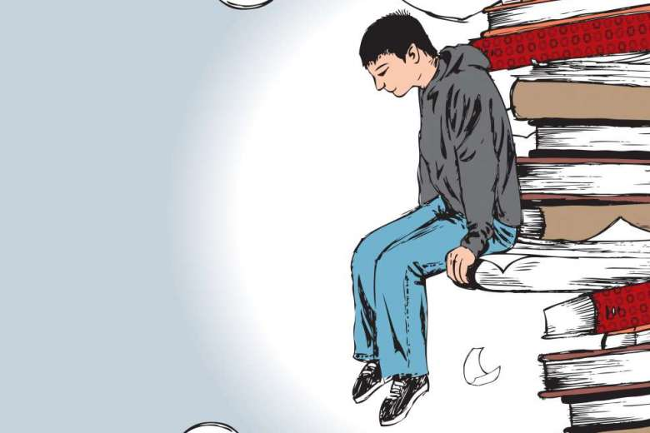
Academic Performance and Low SES
Academic performance is an important inference for societal foundation, learning skills
Low SES = Teen motherhood, depression, lack of healthcare, decrease care (Jensen,2009)
Increase Stress (Reiss et al. 2019)
Emotional dysregulation and mental health problems
Inability to work in groups, not working on school assignments (Valiente, Carlos et al. 2012)
Receive poor grades
More likely to drop out of school, increased societal exclusion, and even decreased health outcomes (Hughes, Cao, West, Allee Smith, & Cerda, 2017).
Notes:
Academic performance has evidence to be important for societal foundation and developing learning skills.
People who have low academic performance, are more likely to drop out and have other behavior problems due to result from a causal sequence of events that stem from LOW SES
From increasing stress to most likely receiving poor grades

Slide 6

Race/Ethnicity and Academic performance
Majority of students in poor school districts are African Americans and Hispanics (Kim, Mazza, Zwanziger, & Henry, 2014).
Minority groups do poorly in academic performance compared to whites, can be due to higher reports of discrimination and treatment in the school system (American Psychology Association, 2017)
Indicating achievement disparities in the education system and living envitonment.
Notes:
Studies have shown that Individuals who are mostly low SES are African Americans and Hispanics. This is due to the fact, that many come from poor school districts and do poorly academically compared to whites
due to higher reports of discrimination and treatment from not only their school system but from their living environment as well.
Some of these marginalization factors attribute to higher rates of stress, tension, lack of communication and fear.

Slide 7

Crime on Low SES, and Academic Performance
Low SES live in areas that have high crime rates (Moffitt & Klaus-Grawe Think, 2013)
Higher rate of being involved or witnessing crime and violence
More Stress
Decrease cognitive function of the brain (Cybele Raver & Blair, 2016).
Memory retention
Academic performance
Increases maladaptive behaviors (Haynie, Silver, & Teasdale, 2006)
Aggressiveness, violent behavior
Creates consequences towards academic performance(Haynie, Silver, & Teasdale, 2006).
Notes:
According to literature, low SES areas have high crime rates. Individuals who live in these areas, have been found to have prolonged exposure that increases stress due witnessing crime and violence.
This increase stress, which leads to decreased cognitive function of the brain which lowers memory retention and academic performance.
Individuals are also more aggressive and violent which then creates consequences towards academic performance such as more fights and drop outs at school.

Slide 8


Food Deserts on Low SES, and Academic Performance
Food deserts are areas that are considered to not have access to affordable healthy nutritious food but replaced with food sources that sell high saturated fats and carbohydrates (Widener, Metcalf, & Bar-Yam, 2012)
Research conducted in Food deserts has shown (Frndak, 2014).
Decrease in academic performance.
Increased consumption of high saturated fats and carbs can lead to detrimental cognitive effects that lead to poor academic performance.
Areas of food deserts and high crime rates thrive together in low SES areas (Crowe, Lacy, & Columbus, 2018)
Notes:
Now we will talk about the effects of LOW SES, and academic performance in food deserts
Food deserts are areas that have less access to healthy foods but are replaced with food sources that sell high fats and carbs.
Individuals who are less SES report of having increased consumption of high saturated fats and carbs. This results in cognitive effects that lead to poor academic performance due to poor diet.
In fact, studies have shown that areas of food deserts and high crimes rates thrive together in low SES areas.

Slide 9
Support
Family support towards a child’s education in low SES areas have shown to do better than individuals who did not have family support while living in the same environment (Conger, Conger, & Martin, 2010)
Social support from family, friends and teachers from school have acted as a buffer for better academic performance (Rezaei-Dehaghani, Keshvari, & Paki, 2018)
Even when a child comes from a low socioeconomic setting that has high rates of socioeconomic stressors that lead to poor cognitive learning.
When a child is neglected by family
Maladaptive behavior increase → leads to poorer academic performance
High correlation between neglect and poverty level(Herruzo, Raya Trenas, Pino, & Herruzo, 2020)
Notes:
Although regions of poverty are afflicted by crime and food deserts which lower academic performance. There is evidence where social support plays a pivotal role in
The lives of adolescence. For example, Family support towards a child’s education in low SES areas have shown to do better than individuals who did not have family support while living in the same environment.
However, in contrast, most children in low SES communities are neglected by family. Because of this, they exhibit poor academic performance.

Slide 10

California Assessment of Student Performance and Progress Test
California Students each year are required to take the CAASPP test
Math
English Language Arts
Test (1-2 hr) given in a computer and online format
Score helps categorizes students’ achievement claim
“Below Standard”
“Near Standard”
“Met Standard”
“Above Standard”
Claims help indicate the advancement to the next grade level and graduation.
Notes:
Academic performance can be indicated by the California Assessment of Student Performance and Progress Test also known as CAASSPP.
Which students from California have to take each year.
The CAASP has two tests which is comprised of Mathematics and English Language Arts.
The test indicates categorization of students achievement claims. These claims help indicates advancement to the next grade level and even graduation.

Slide 11
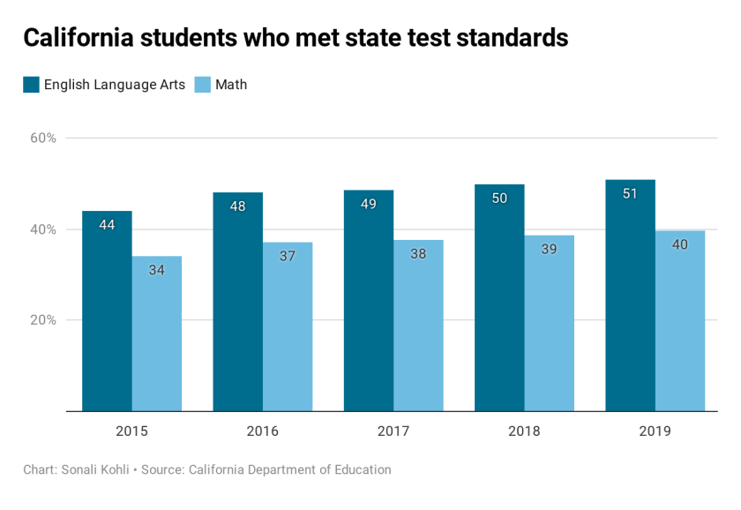
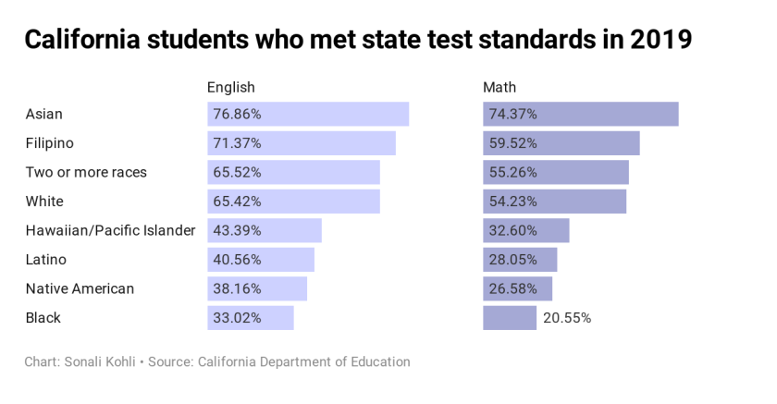
CAASPP California Test Results
Notes:
We see that students test scores in California has been increasing over through the years but it is a generalize output of California scores
However, it does not reflect low SES in particular that investigates environmental factors such as high crime rate, food environment, and poverty.
So let’s dive in the research questions

Slide 12

Research Question
What role does support play in the SBCUSD (San Bernardino City Unified School District) students standardized test scores?
How do test scores vary across spatial social factors in San Bernardino?
Notes:
And this is my research questions
The first question…..
The second question….

Slide 13
Methods
Notes:
So now we will go into the methods…

Slide 14

Population
Participants were students from the San Bernardino City Unified School District (SBCUSD) in Southern California.
The data collected was during the school year of 2018-2019 which comprised of 4^{th,} 5th, 6th, 7th , 8th , and 11th graders who’ve taken the CAASPP test.
Notes:
Starting with the population,
JUST READ

Slide 15

Collection of Data
CAASP Test results from SBCUSD
A climate survey instrument created by Loma Linda University was distributed to SBCUSD measured
School climate
Social Emotional learning
Risky behaviors
Support (Outside, Home, School)
CAASP test results and climate survey were linked to the student’s record (grade level, home zip code, gender, free or reduced lunch which can determine their SES status).
De-identified (LLU student ID marker)
Notes:
For the collection of data,
We received the test results from the school district.
A survey was created by loma linda university to measure school climate, social emotional learning, potential risky behaviors, and support from students environment such as home, school, and outside home and school.

Slide 16
Measures
Outcome Variables: CAASP English and Math (Pass or Fail )
Main Exposures: Home Support, Outside Support, and School Support
Covariates:
Low SES status and Grade level
Age at survey, Gender, and Race/Ethnicity
Notes:
My outcome variables are the CAASP test results which indicates standards met or not met
Exposures are different categories of support.
Covariates are social-demographics and school information such as low SES and grade level

Slide 17
Support
HOME SUPPORT
Questions
“In my home, there is a parent or some other adult…
“Who really cares about me”
“ Who notices when I am upset about something”
“Who I trust”
Responses
“Not at all True”
“A little true”
“Pretty much true”
“Very much true”
OUTSIDE SUPPORT
Questions
“Outside of my home and school, there is an adult…
“Who really cares about me”
“ Who notices when I am upset about something”
“Who I trust”
Responses
“Not at all True”
“A little true”
“Pretty much true”
“Very much true”
SCHOOL SUPPORT
Questions
“Do adults at school encourage you to work hard so you can be successful?”
Adults at this school encourage me to work hard to I can be successful in college or at the job I choose”
“Do teachers give students a chance to take part in classroom discussions or activities”
“ My teachers work hard to help me with my schoolwork when I need it”
Responses
“No, Never”
“Disagree”
“Strongly Disagree”
“Neither Disagree Nor Agree”
“Agree”
“Strongly Agree”
“Yes, some of the time”
“Yes, most of the time”
“Yes, all of the time”
Notes:
These are the questions in terms of the cateogories of support, and each response was measured in a likert scale

Slide 18


Data Analysis
Spatial Analysis
ARC GIS Pro (Version 2.4)
CAASP English (Pass/Fail)
CAASP Math (Pass/Fail)
School support (Yes/No)
Home Support (Yes/No)
Outside Support (Yes/No)
Zip code
Food Environment
Enriched Zip code
Poverty %
USA Average Crime 2019 Index
Logistic Regression
SAS (Version 9.4)
Support (Outside, Home, School)
Covariates
Outcome effect of academic test performance of ELA and Math
Notes:
I performed a spatial analysis and a logistic regression using ARC GIS PRO and SAS respectively.

Slide 19
RESULTS
Notes:
So now we will transition into my results, starting with spatial analysis

Slide 20
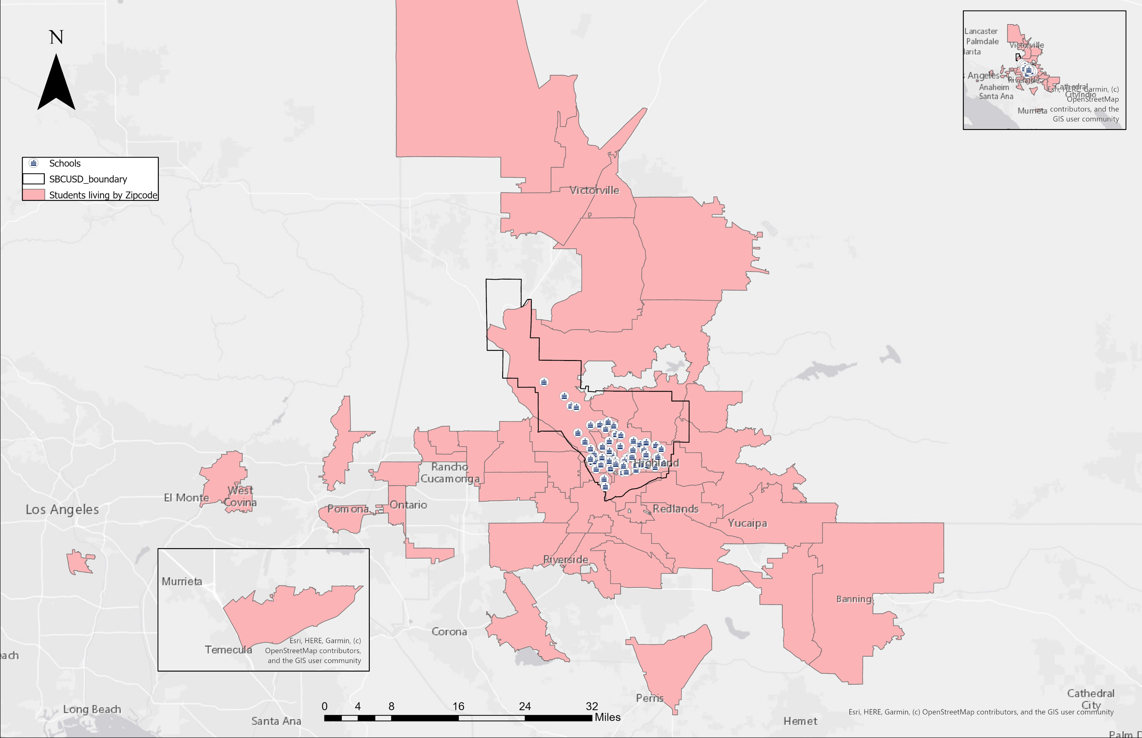
Students living outside and inside SBCUSD boundary
Notes:
Looking at this map, we can see the students living in different zip codes indicated by areas in the shades of pink.
The black bordered area indicated by my mouse, shows the san Bernardino school district boundary.
We notice, that some students that attend the san Bernardino school district live outside the boundary, as far as LA county and Riverside county.

Slide 21
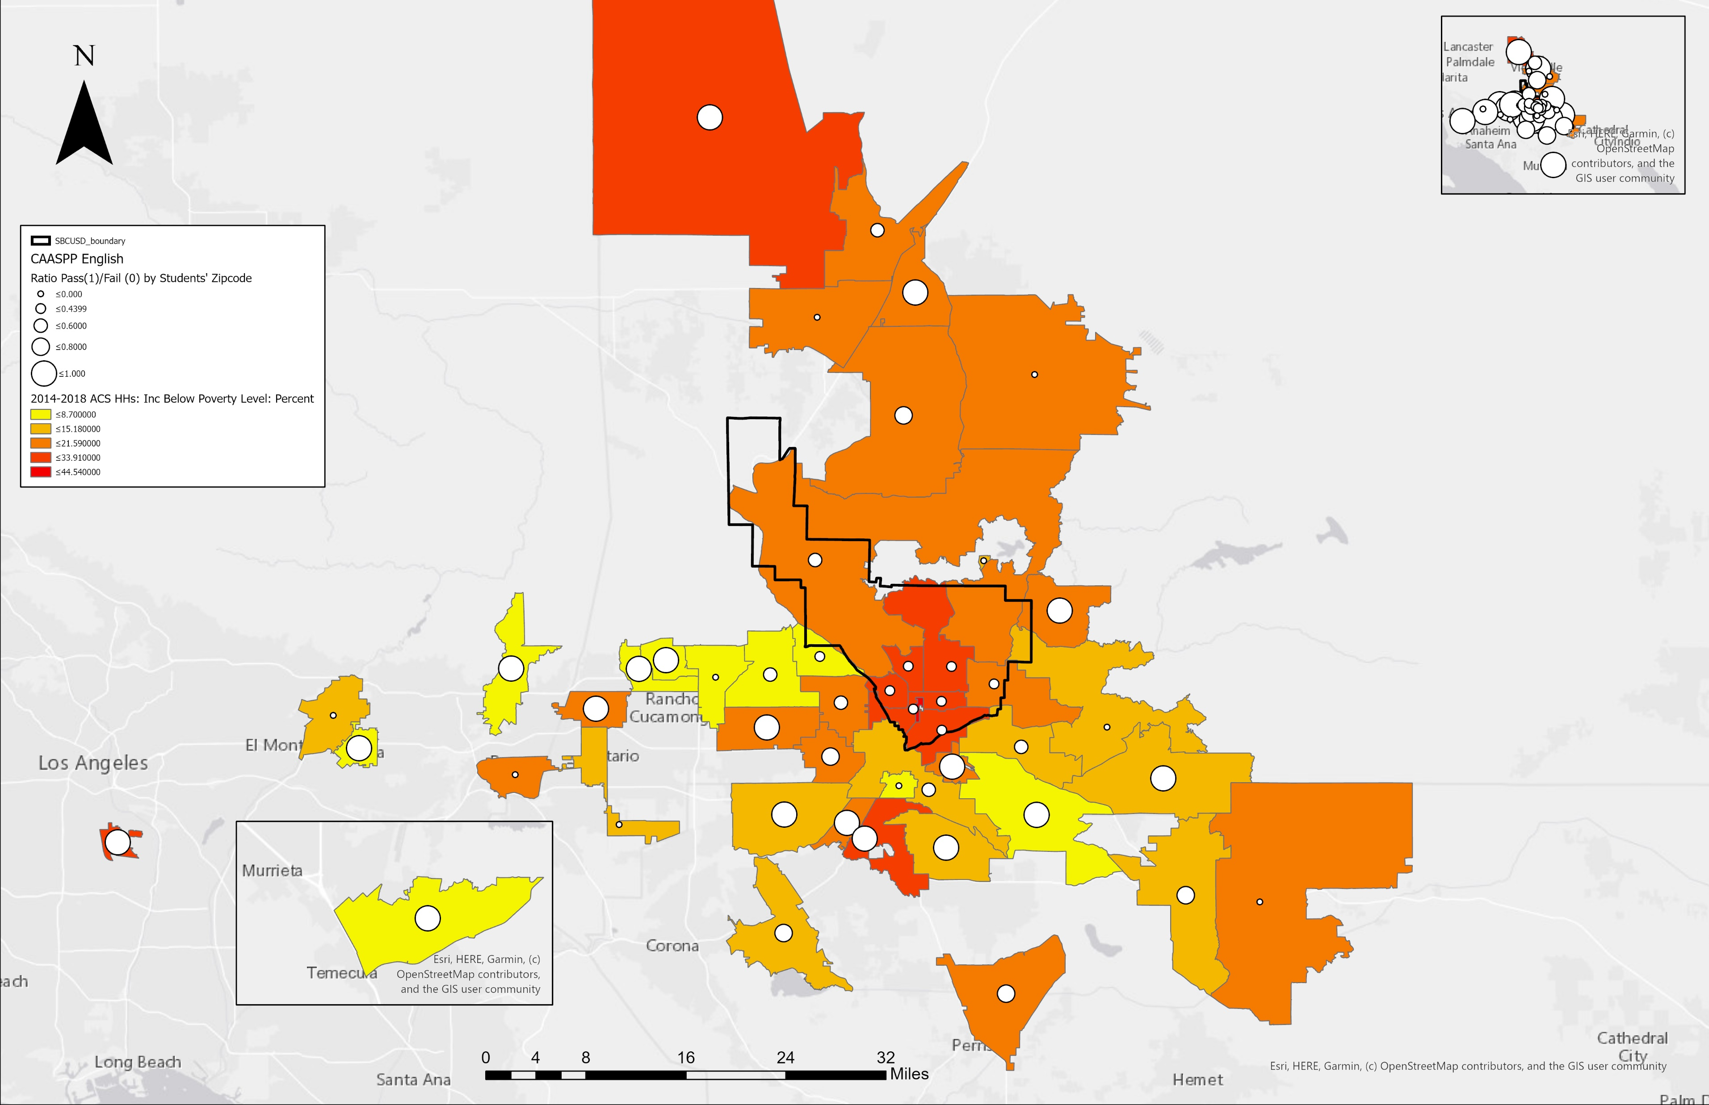
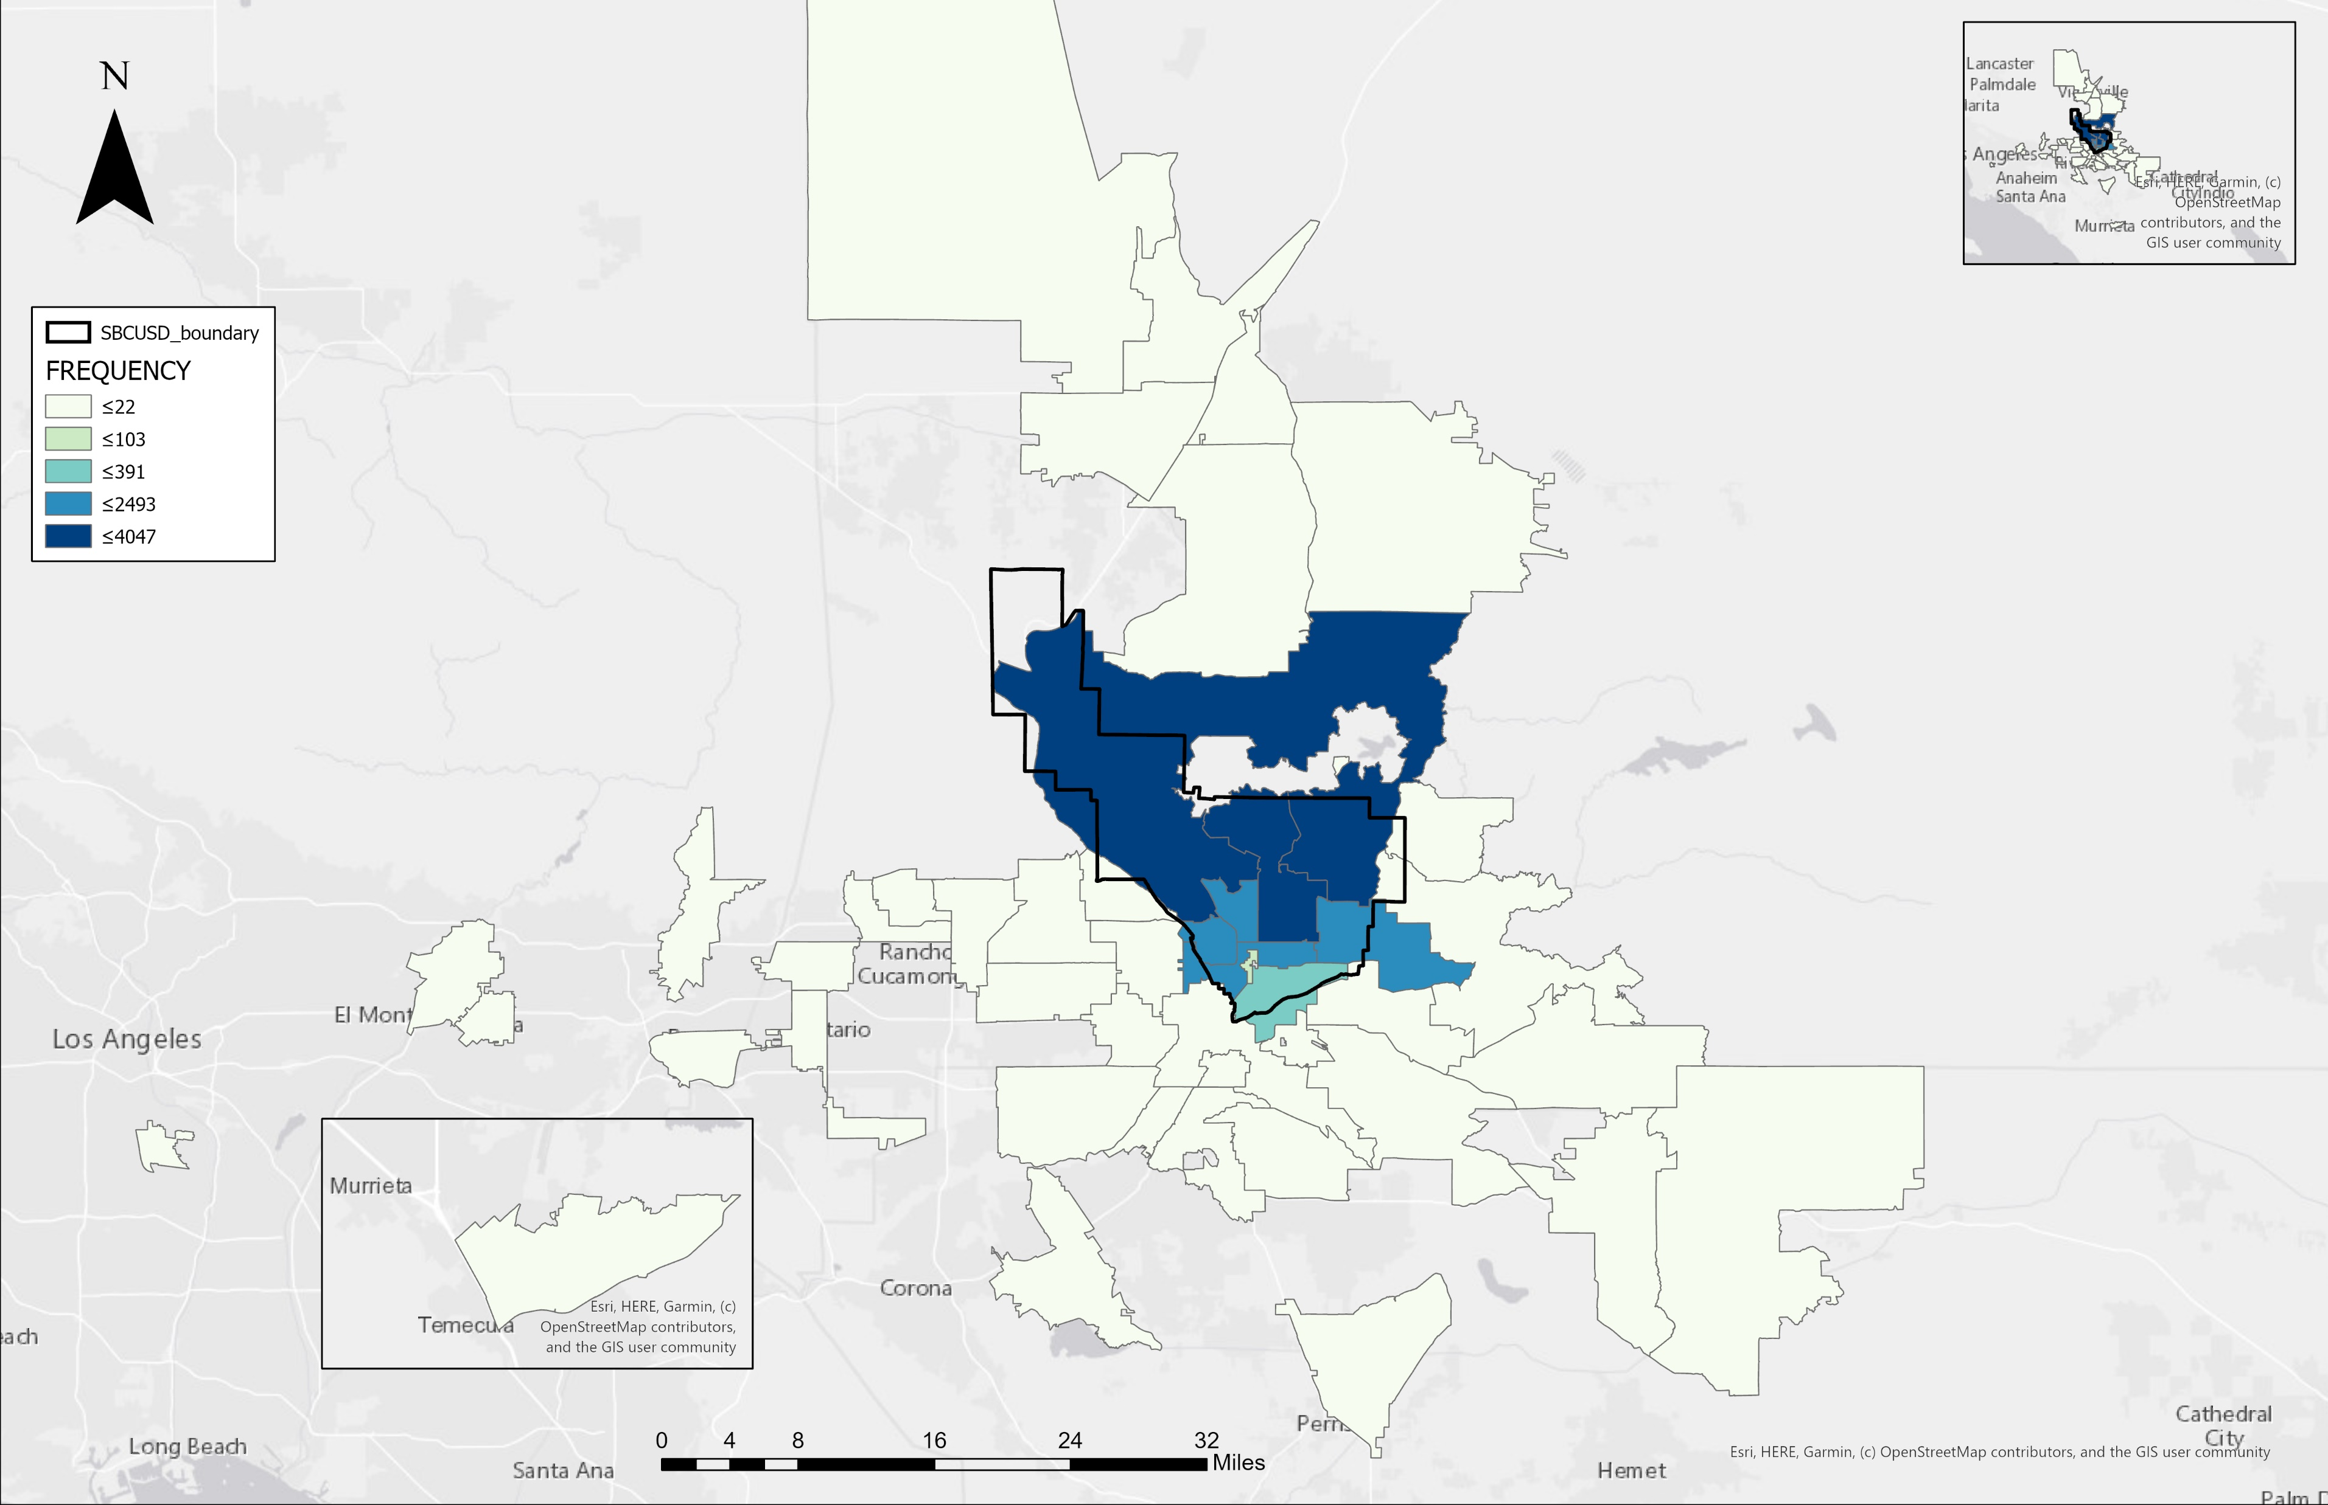
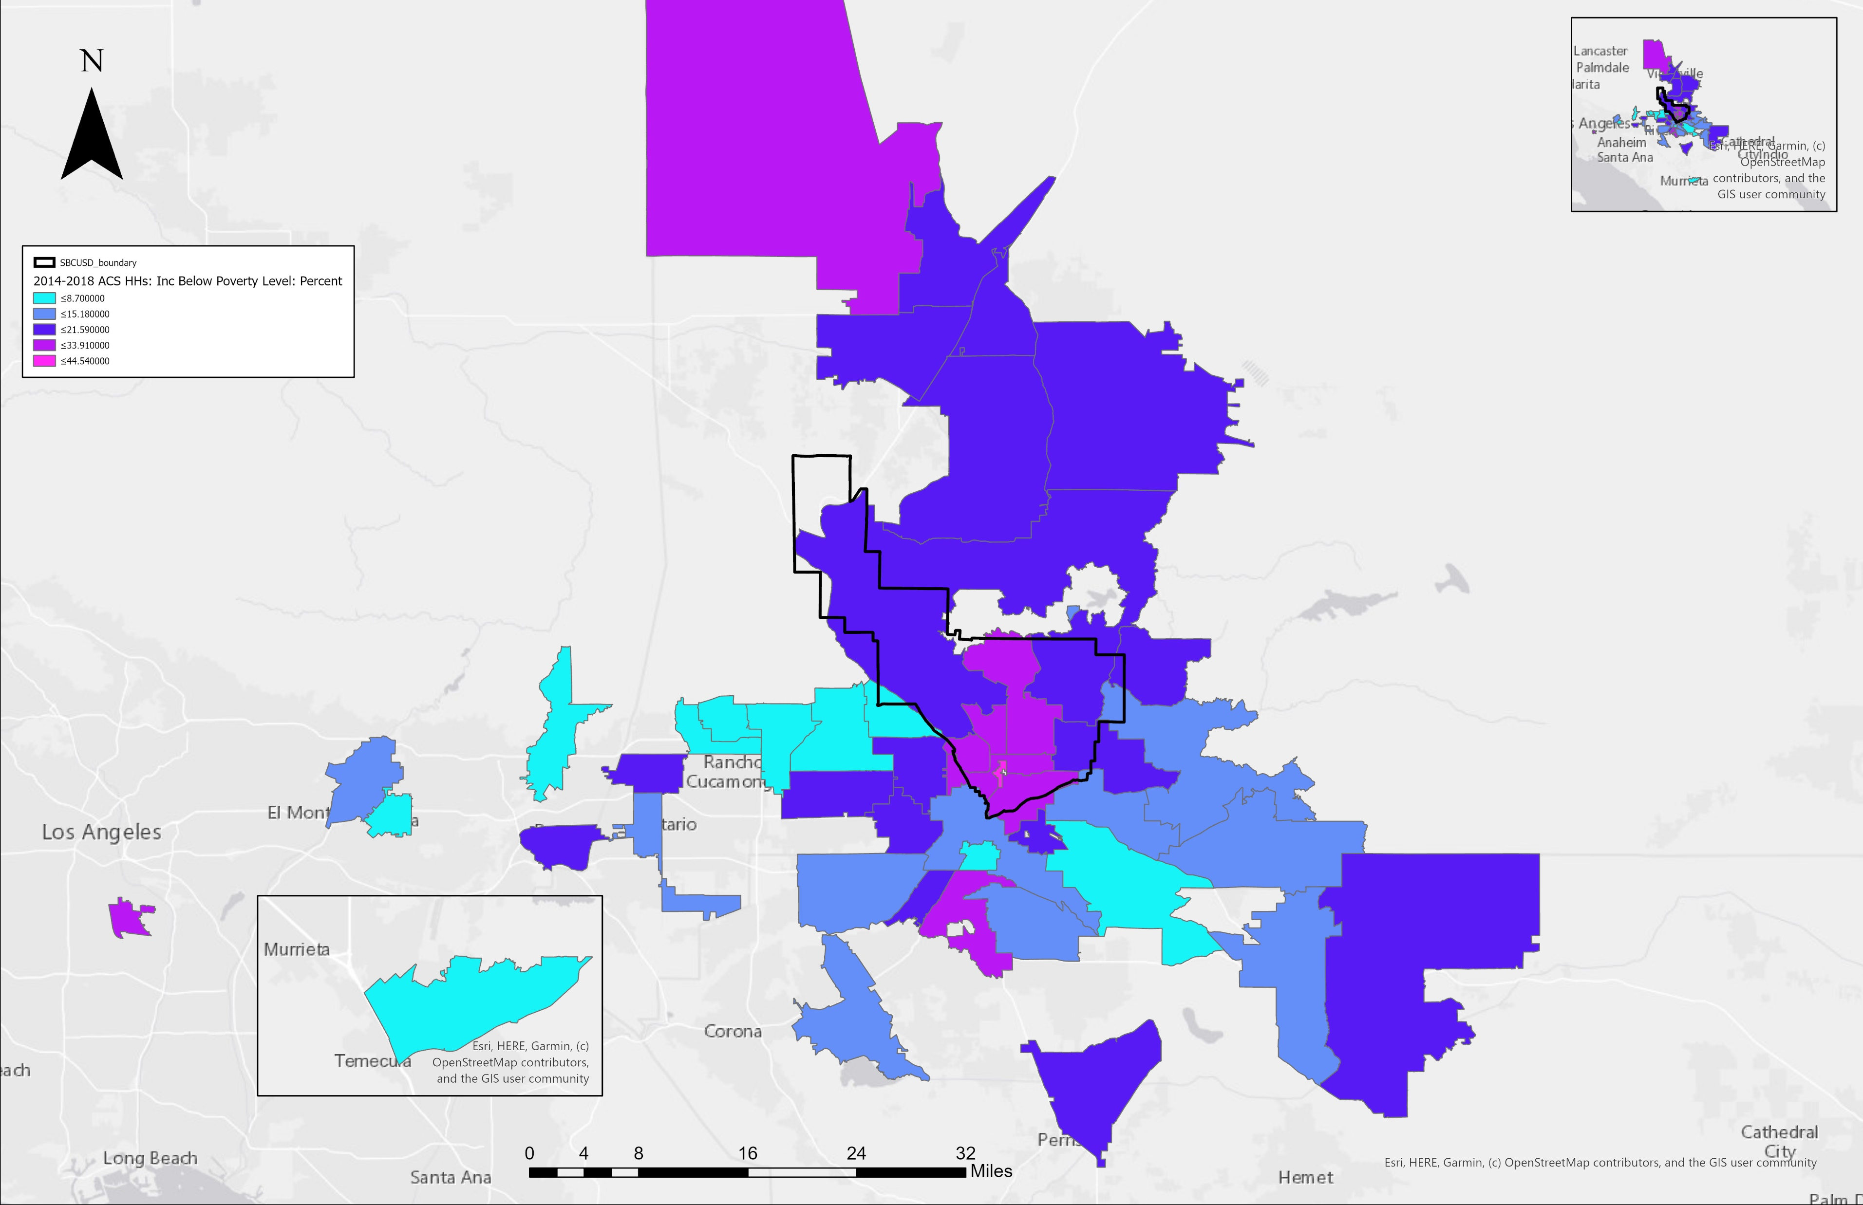
Poverty and English Test Scores
Notes:
When we look at poverty and English Test scores,
We can see that there are different sizes of circles on the map. Bigger circles indicates a higher ratio for passing and smaller circles indicates a higher ratio for failing according to zip code area.
Darker shades of color such as this darker shade of orange, indicates increase percentage of poverty in zip code areas. Lighter shades such as this yellow area indicates
Decrease poverty percentage. As shown, we can see that zip codes with less poverty, there are higher test scores.
We can also to see that there is higher percentages of poverty inside the school district boundary.

Slide 22

Poverty and Math Test Scores
Notes:
And this map has the math test scores plotted on top. It also has the same indication as seen from the previous math.

Slide 23
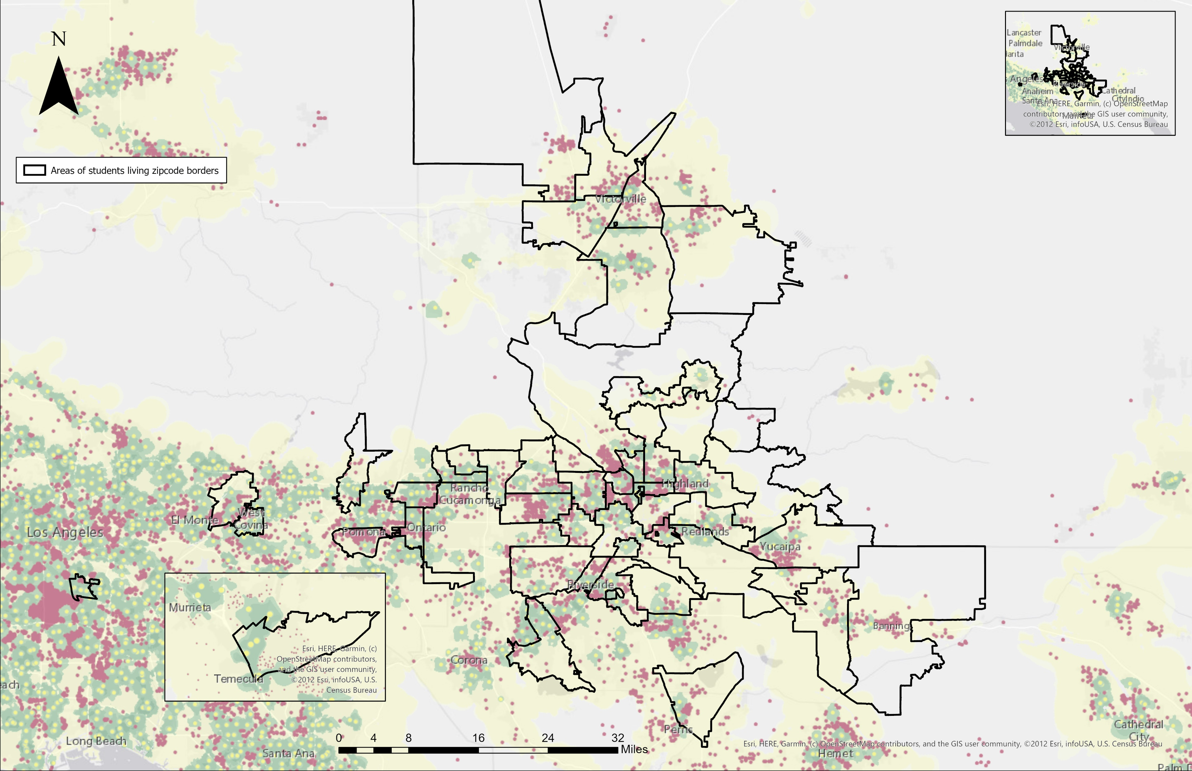
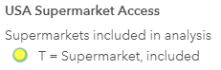
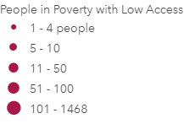
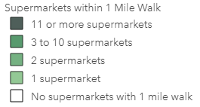
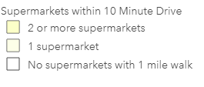
Food Environment
Notes:
Now, looking at the food environment, the red dots indicates individuals who are living in poverty who have less access to supermarkets and grocery stores.
The green areas indicates if the supermarkets are in a walkable distance from their homes. The yellow dots, indicates the actual locations of the supermarkets.

Slide 24
Food Environment
Notes:
It may be a bit hard to see but comparing areas like Rancho Cucamonga, the area near los angels county, and Temecula we can see less red dots compared to the area that’s in the san Bernardino school district.
This shows that areas outside the boundary have the decrease amount of people in poverty with less access to food.

Slide 25
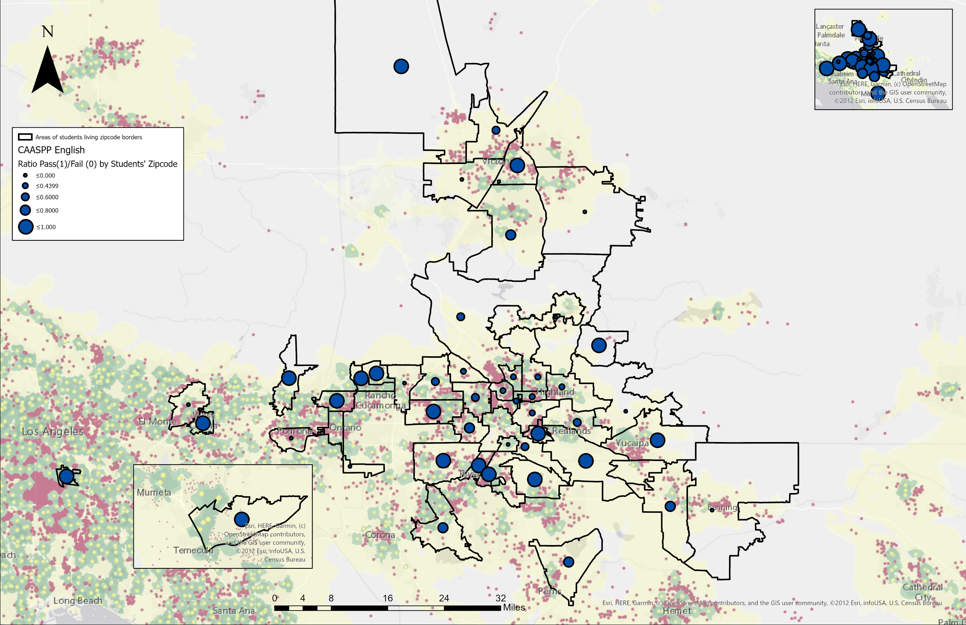
Food Environment and English Test Scores
Notes:
We also plotted test scores according to zip code area and we can see that better access to grocery stores and market places indicates better test scores for both english….

Slide 26
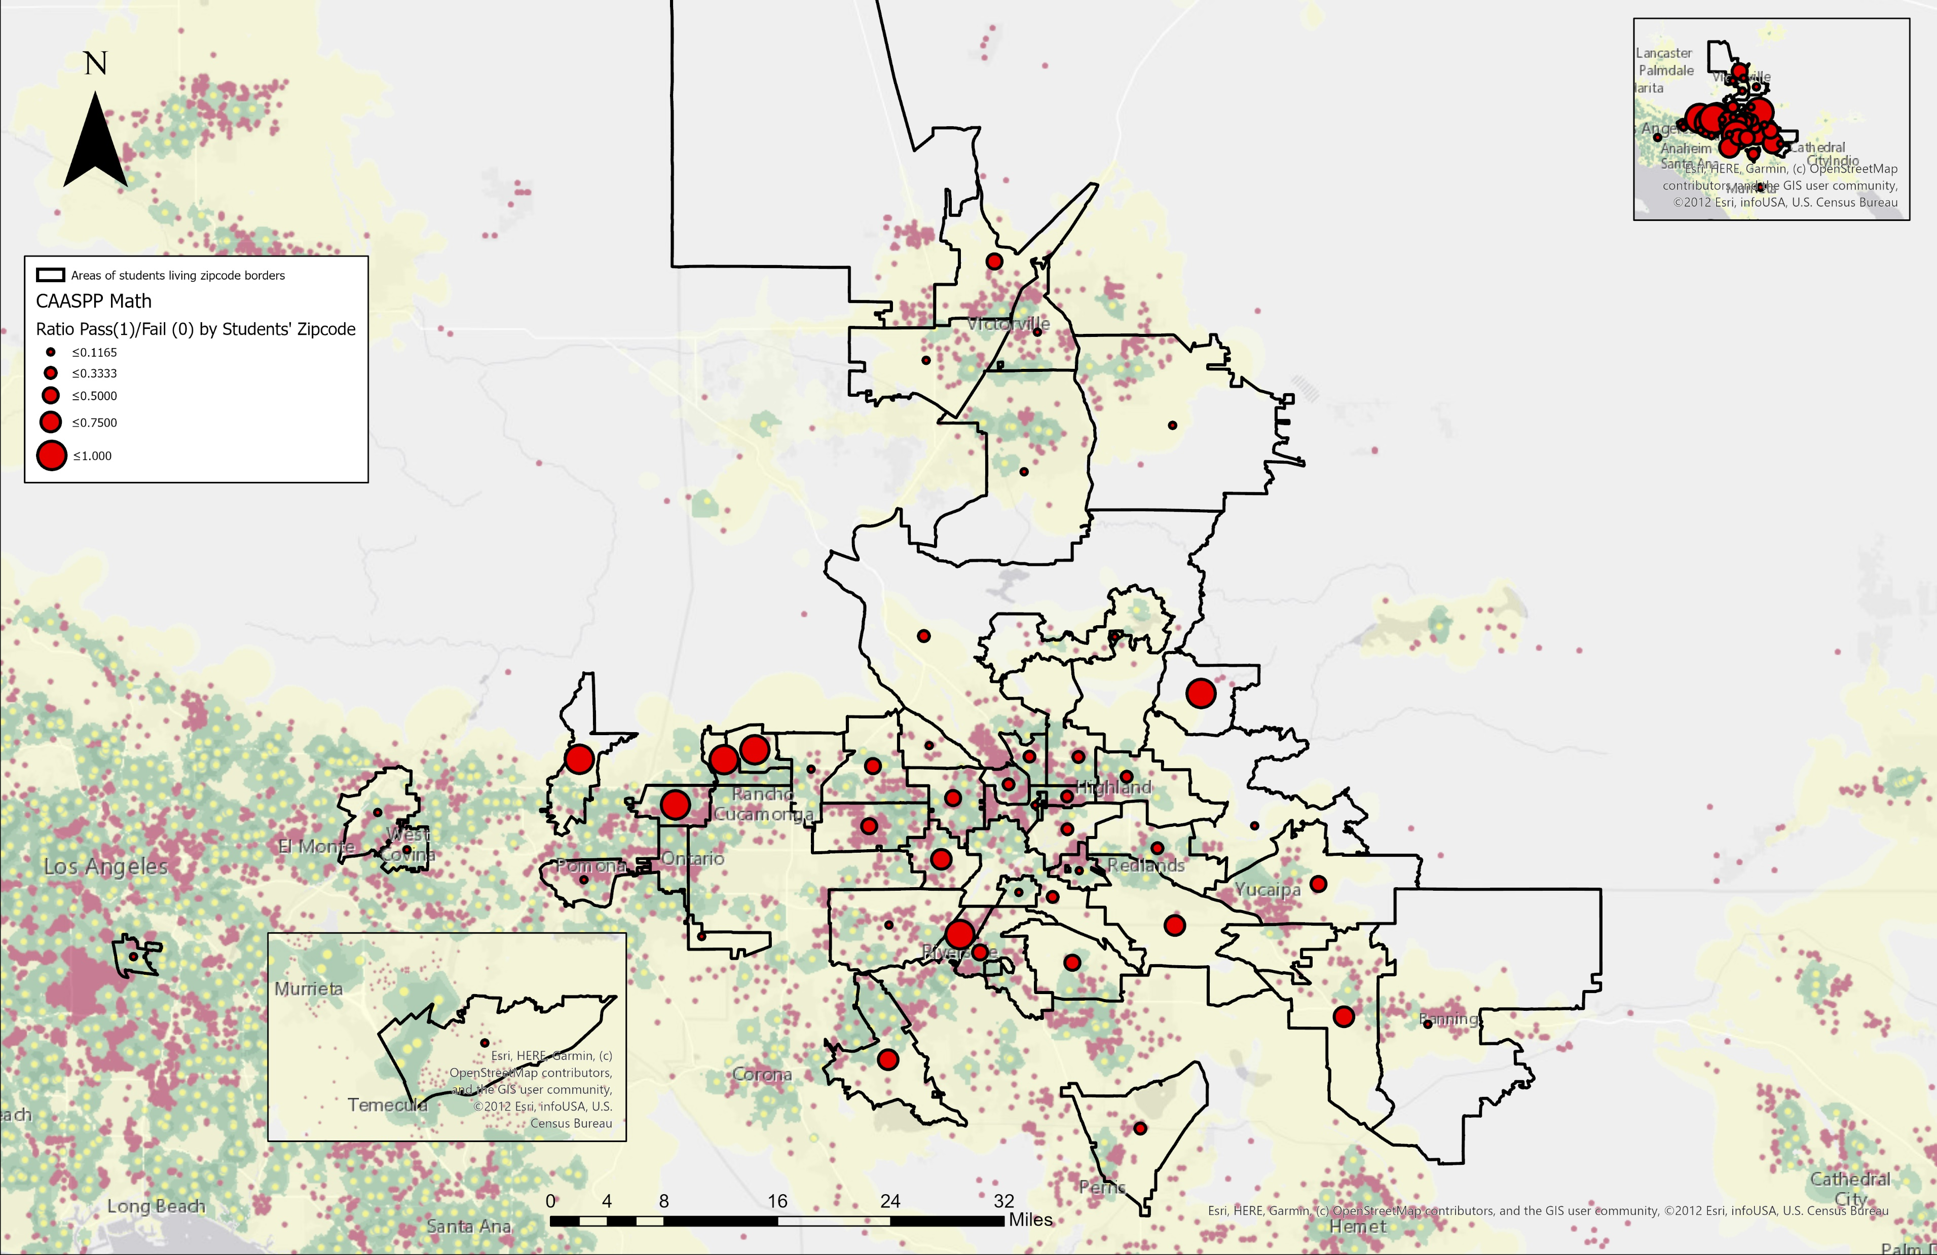
Food Environment and Math Test Scores
Notes:
And math.

Slide 27
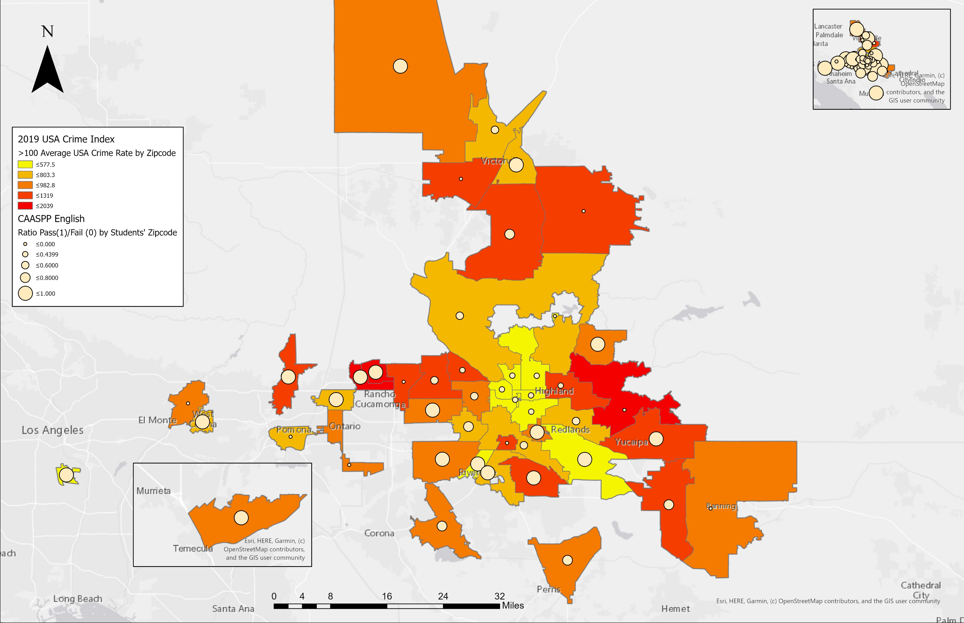
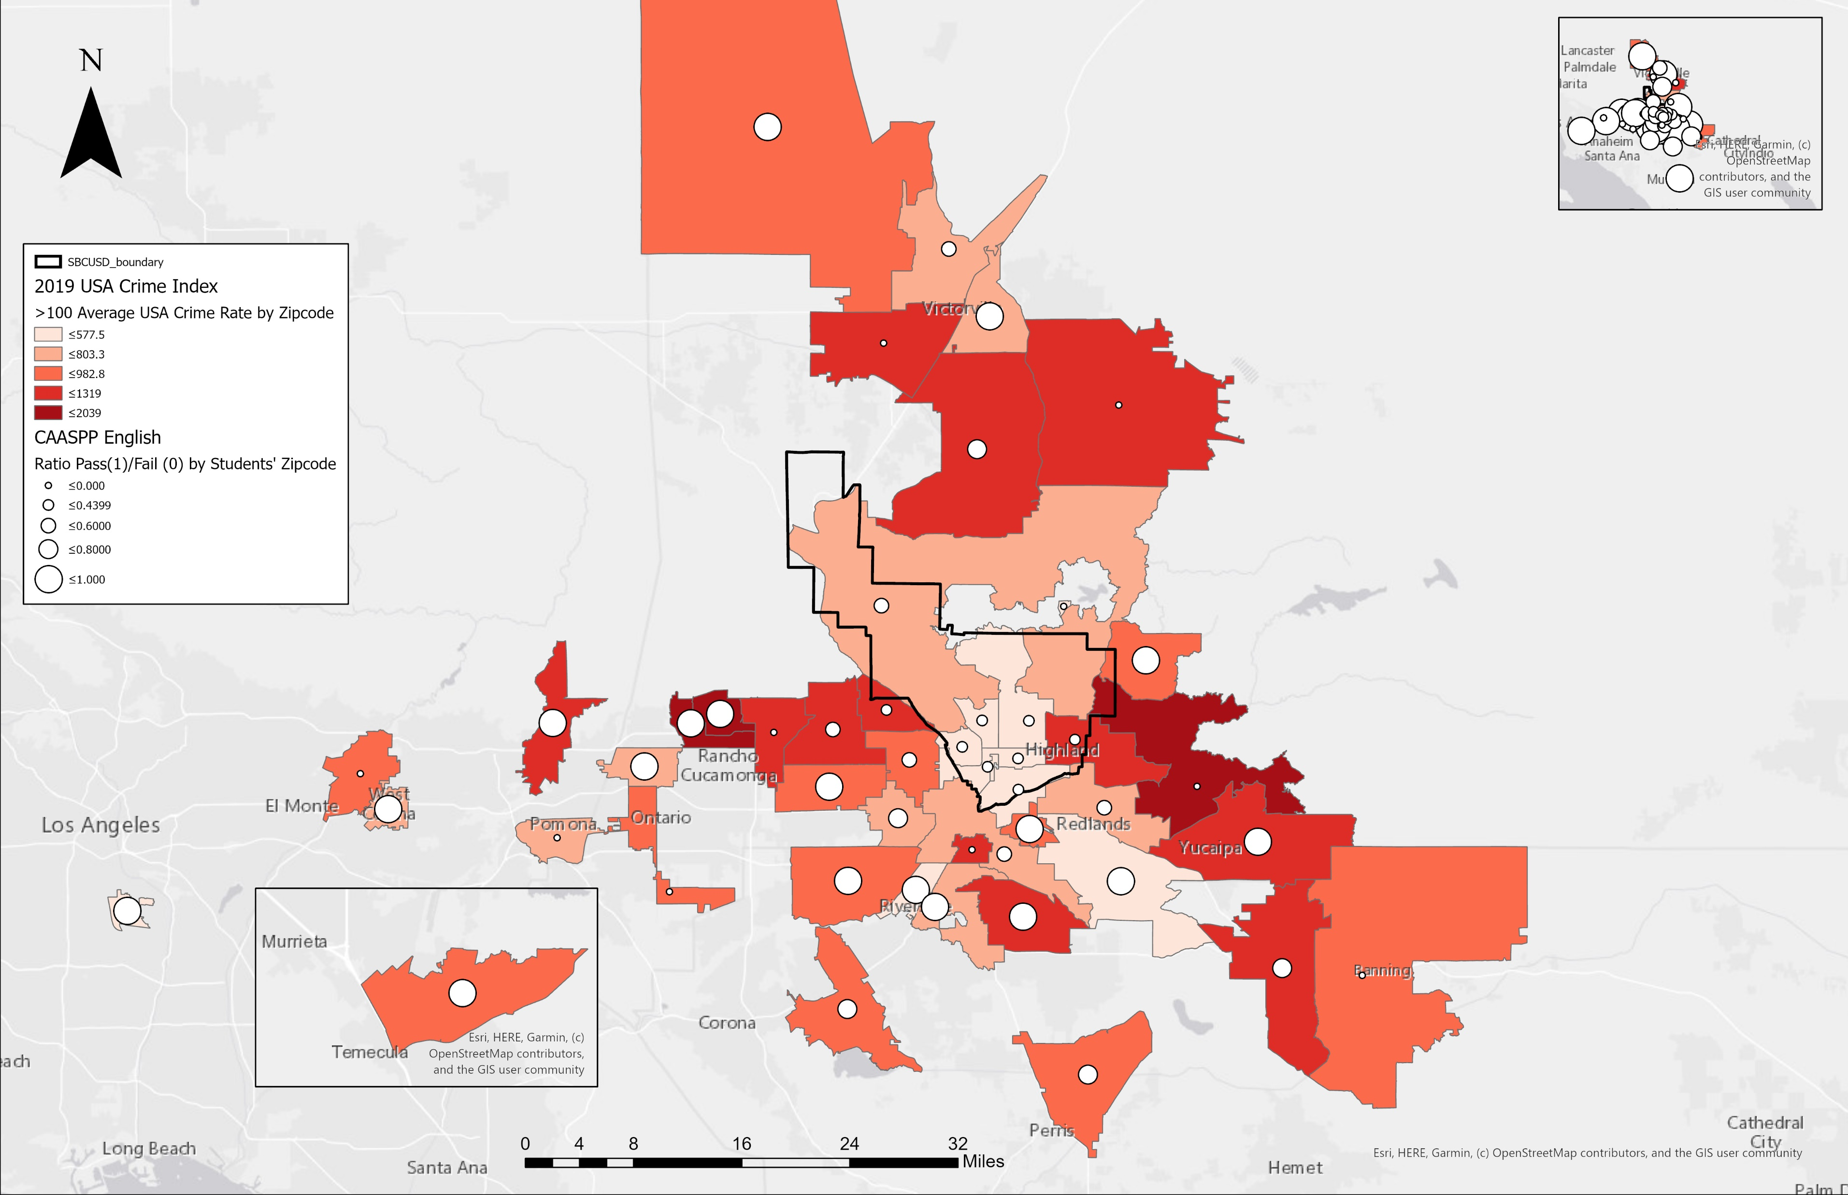
English Test Scores by 2019 USA Crime Index
Notes:
Now, looking at Average USA Crime index or rate, we can see that darker shades of red, where my mouse is pointing at, indicates high crime rate.
However, all areas of where students are living.
In general, live in areas that have higher crime rates than the usa average.
It is hard to distinguish if there is a pattern with crime rate and test scores.
Like how we see English test scores and….

Slide 28


Math Test Scores by 2019 USA Crime Index
Notes:
math

Slide 29
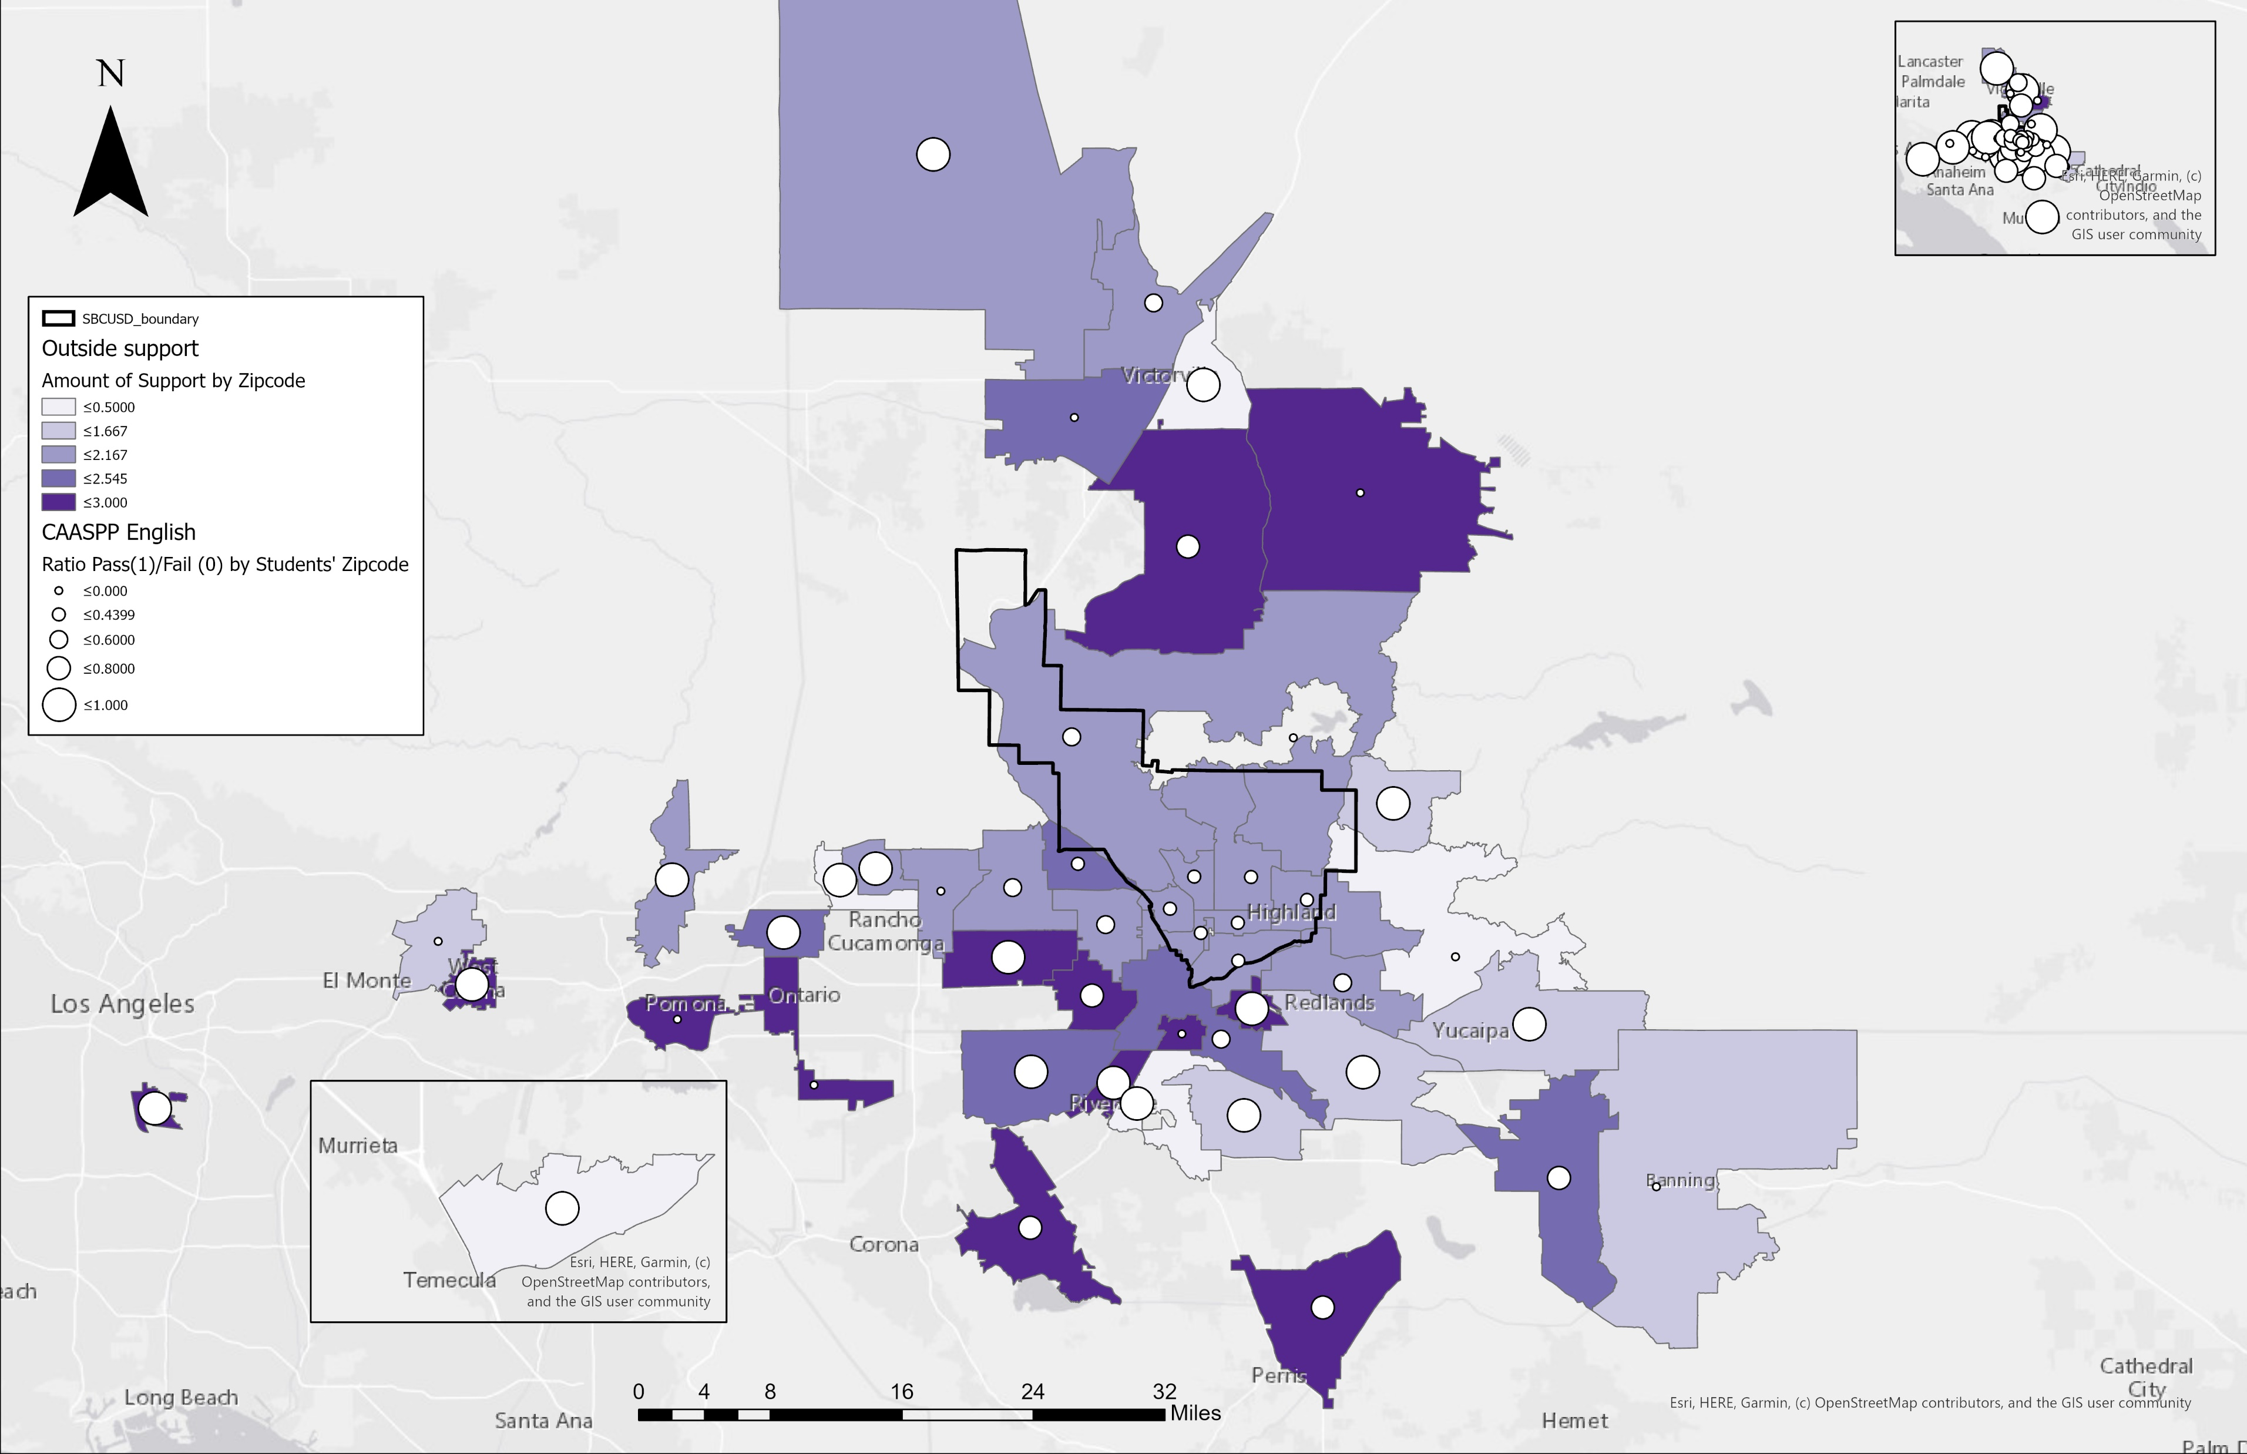
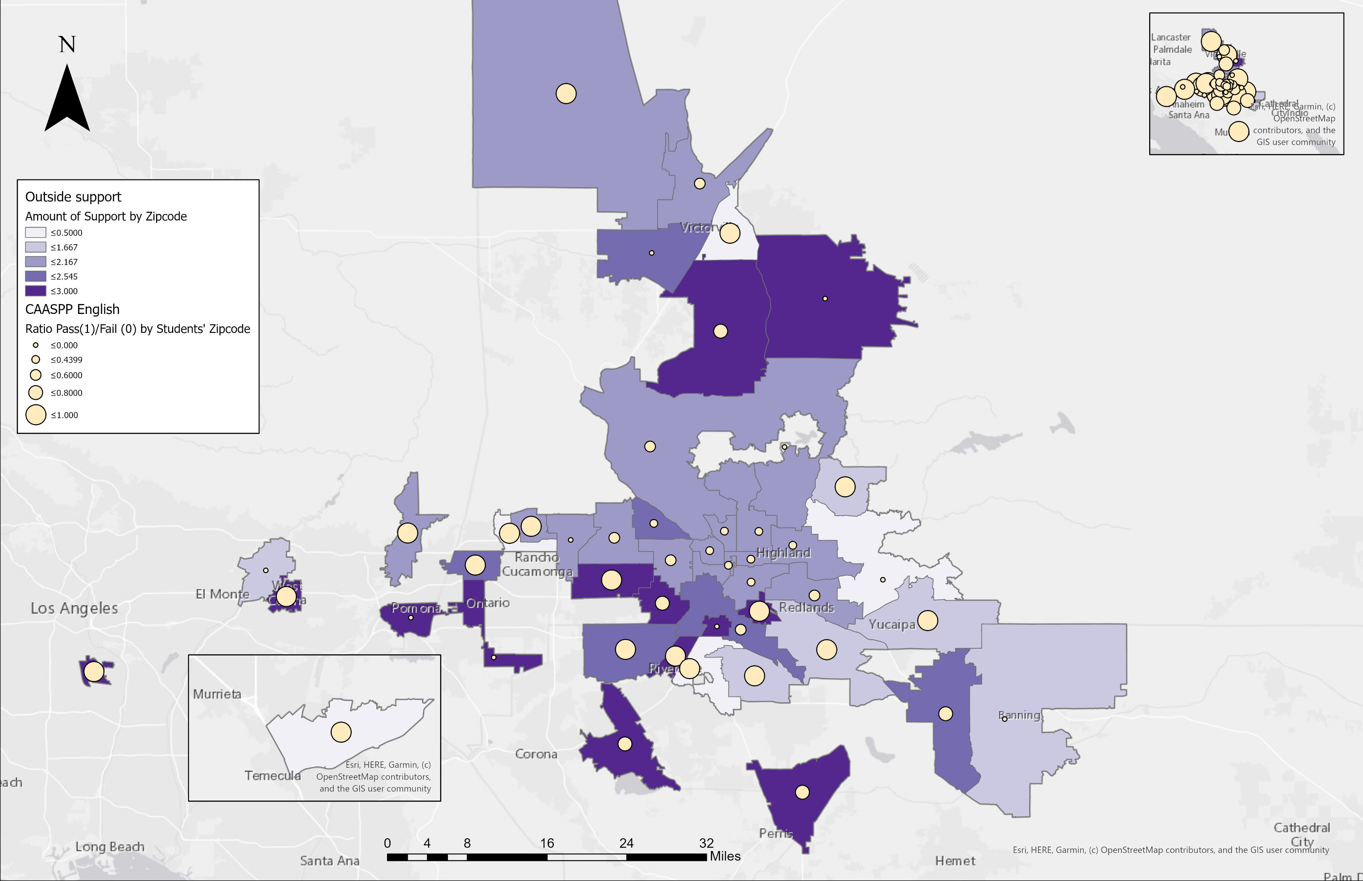
Outside support and English Test Scores
Notes:
This map is based on outside support. We can see that darker shades of purple indicates increased support from family and friends outside school and home environment.
We can see that there is more support outside the school district boundary.
We can also indicate that student test scores are higher outside the school district boundary according to increasing outside support.

Slide 30
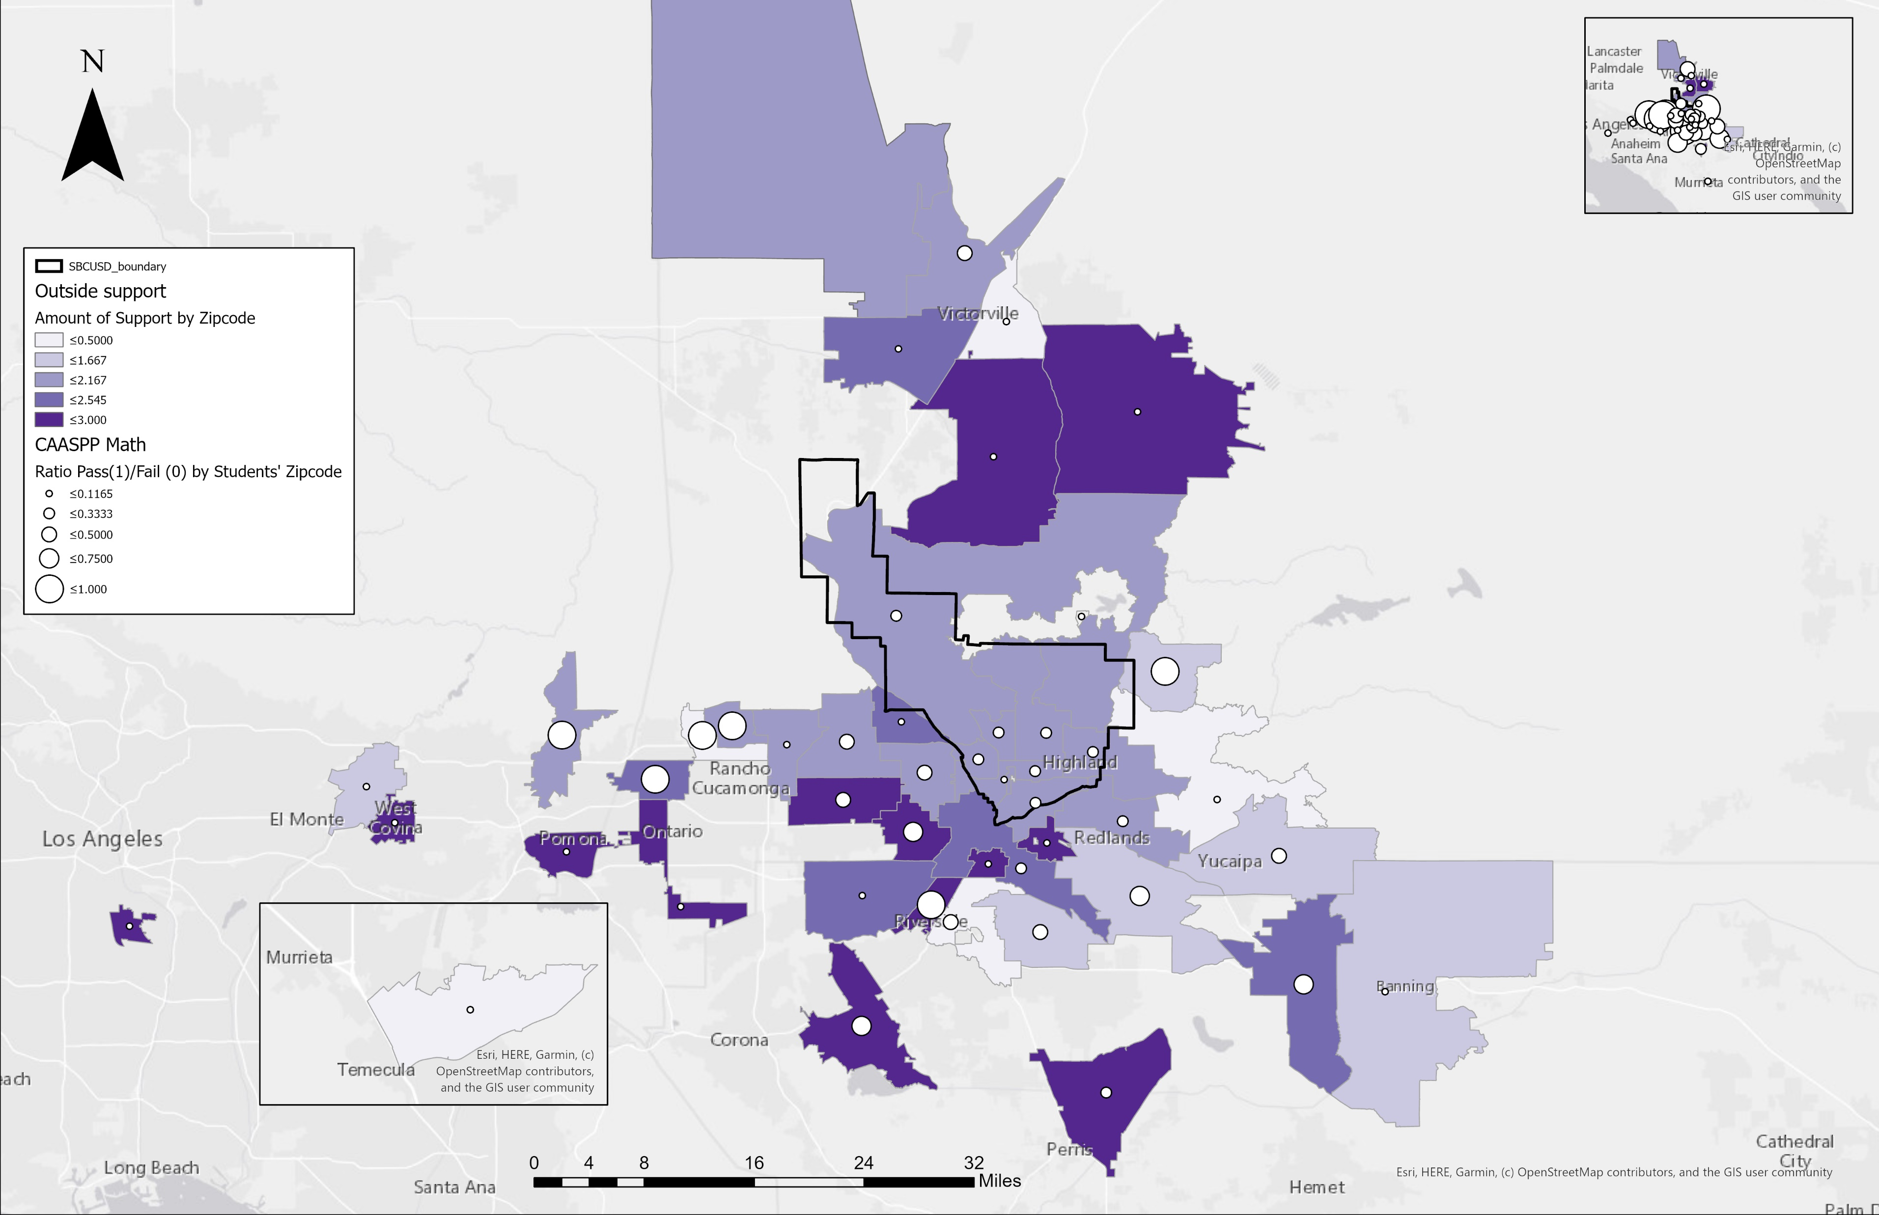
Outside support and Math Test Scores
Notes:
Also for math.

Slide 31
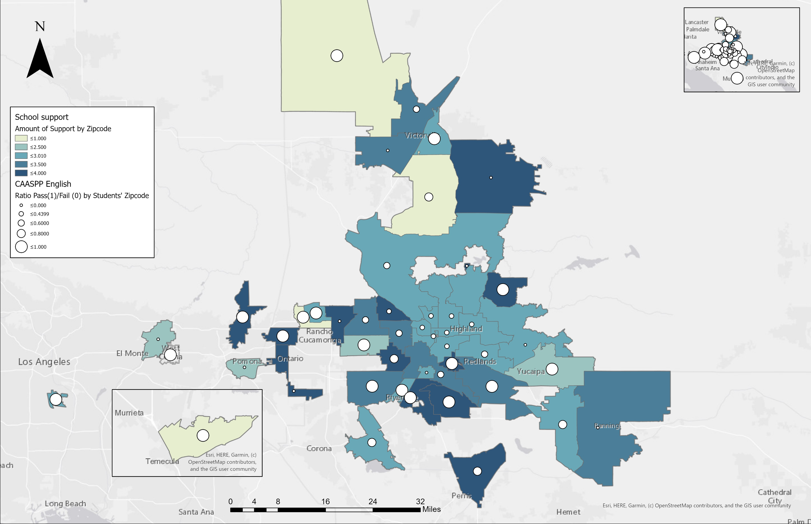


School support and English Test Scores
Notes:
This map is based on outside support. We can see that darker shades of blue indicates increased support from school environment.
We also see the same trend in support for english

Slide 32
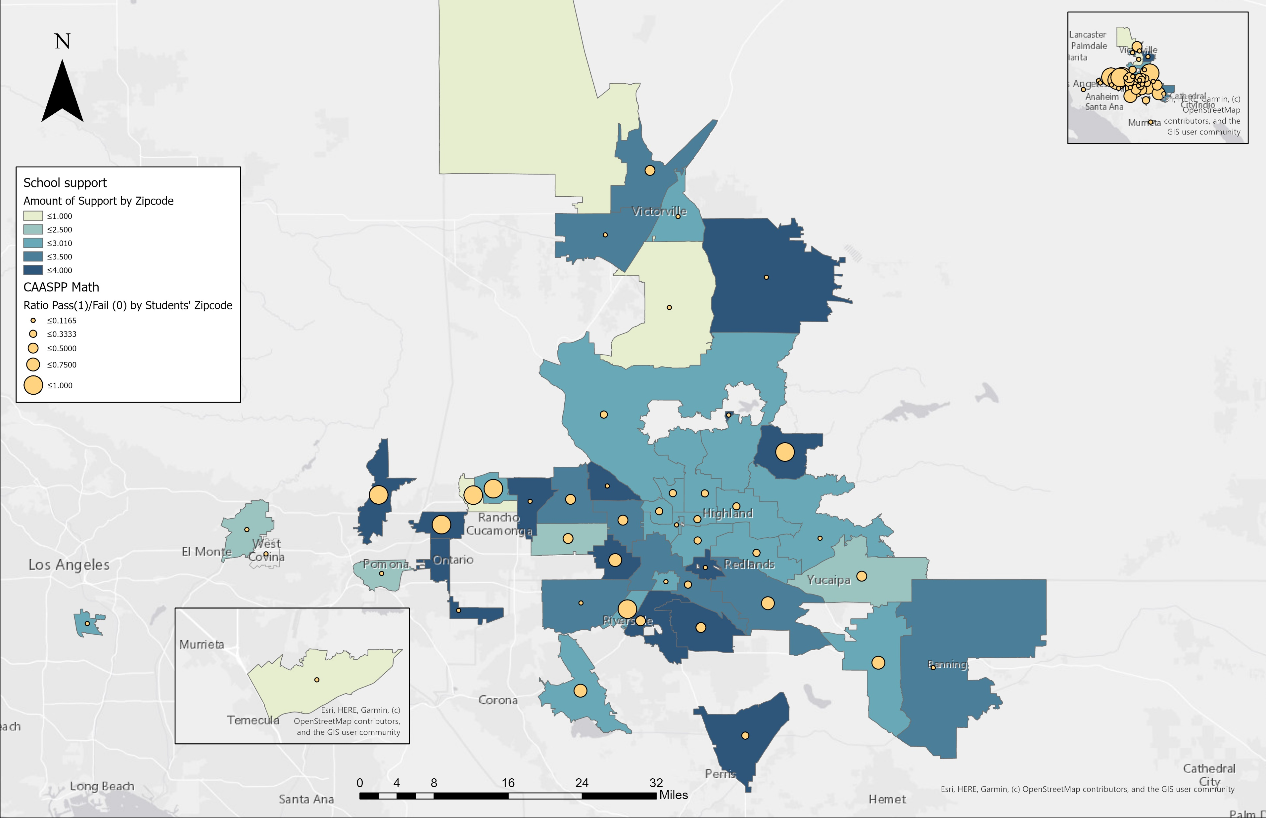

School support and Math Test Scores
Notes:
And math test scores.

Slide 33
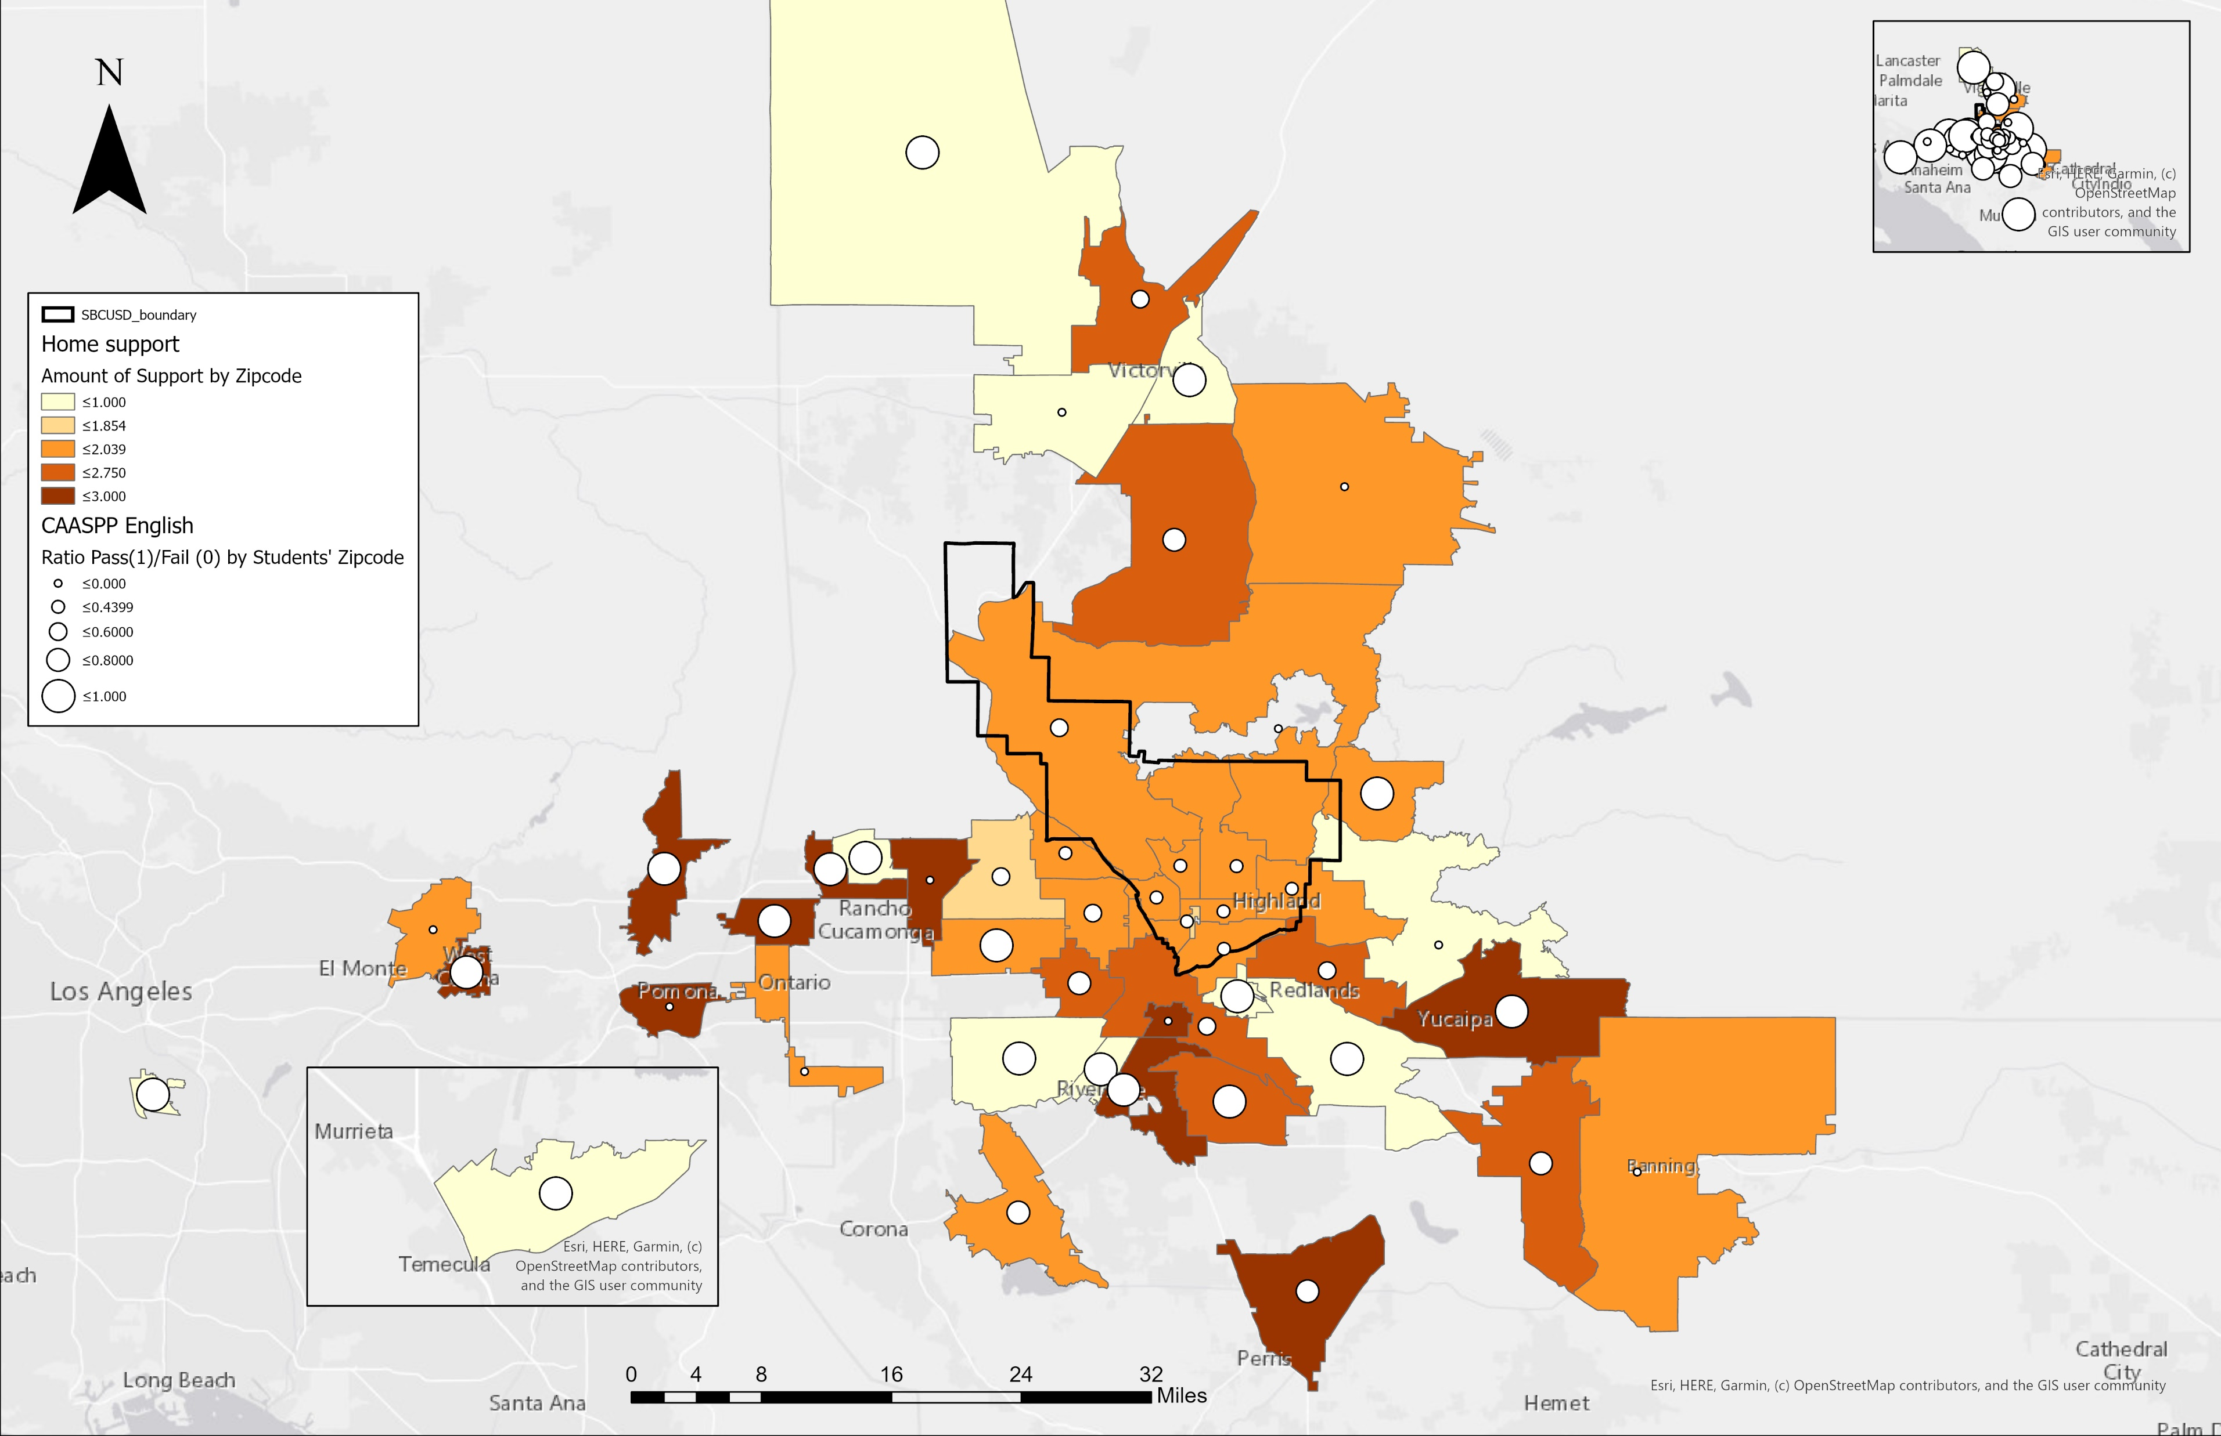
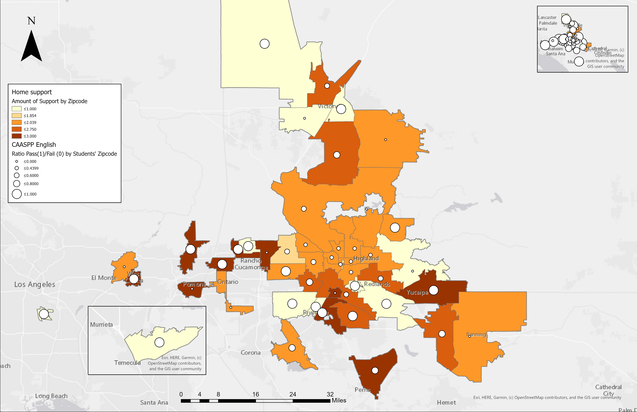
Home support and English Test Scores
Notes:
This also has the same trend as we seen in the previous support map, and we can also see better test scores in with more support areas for both english and…

Slide 34
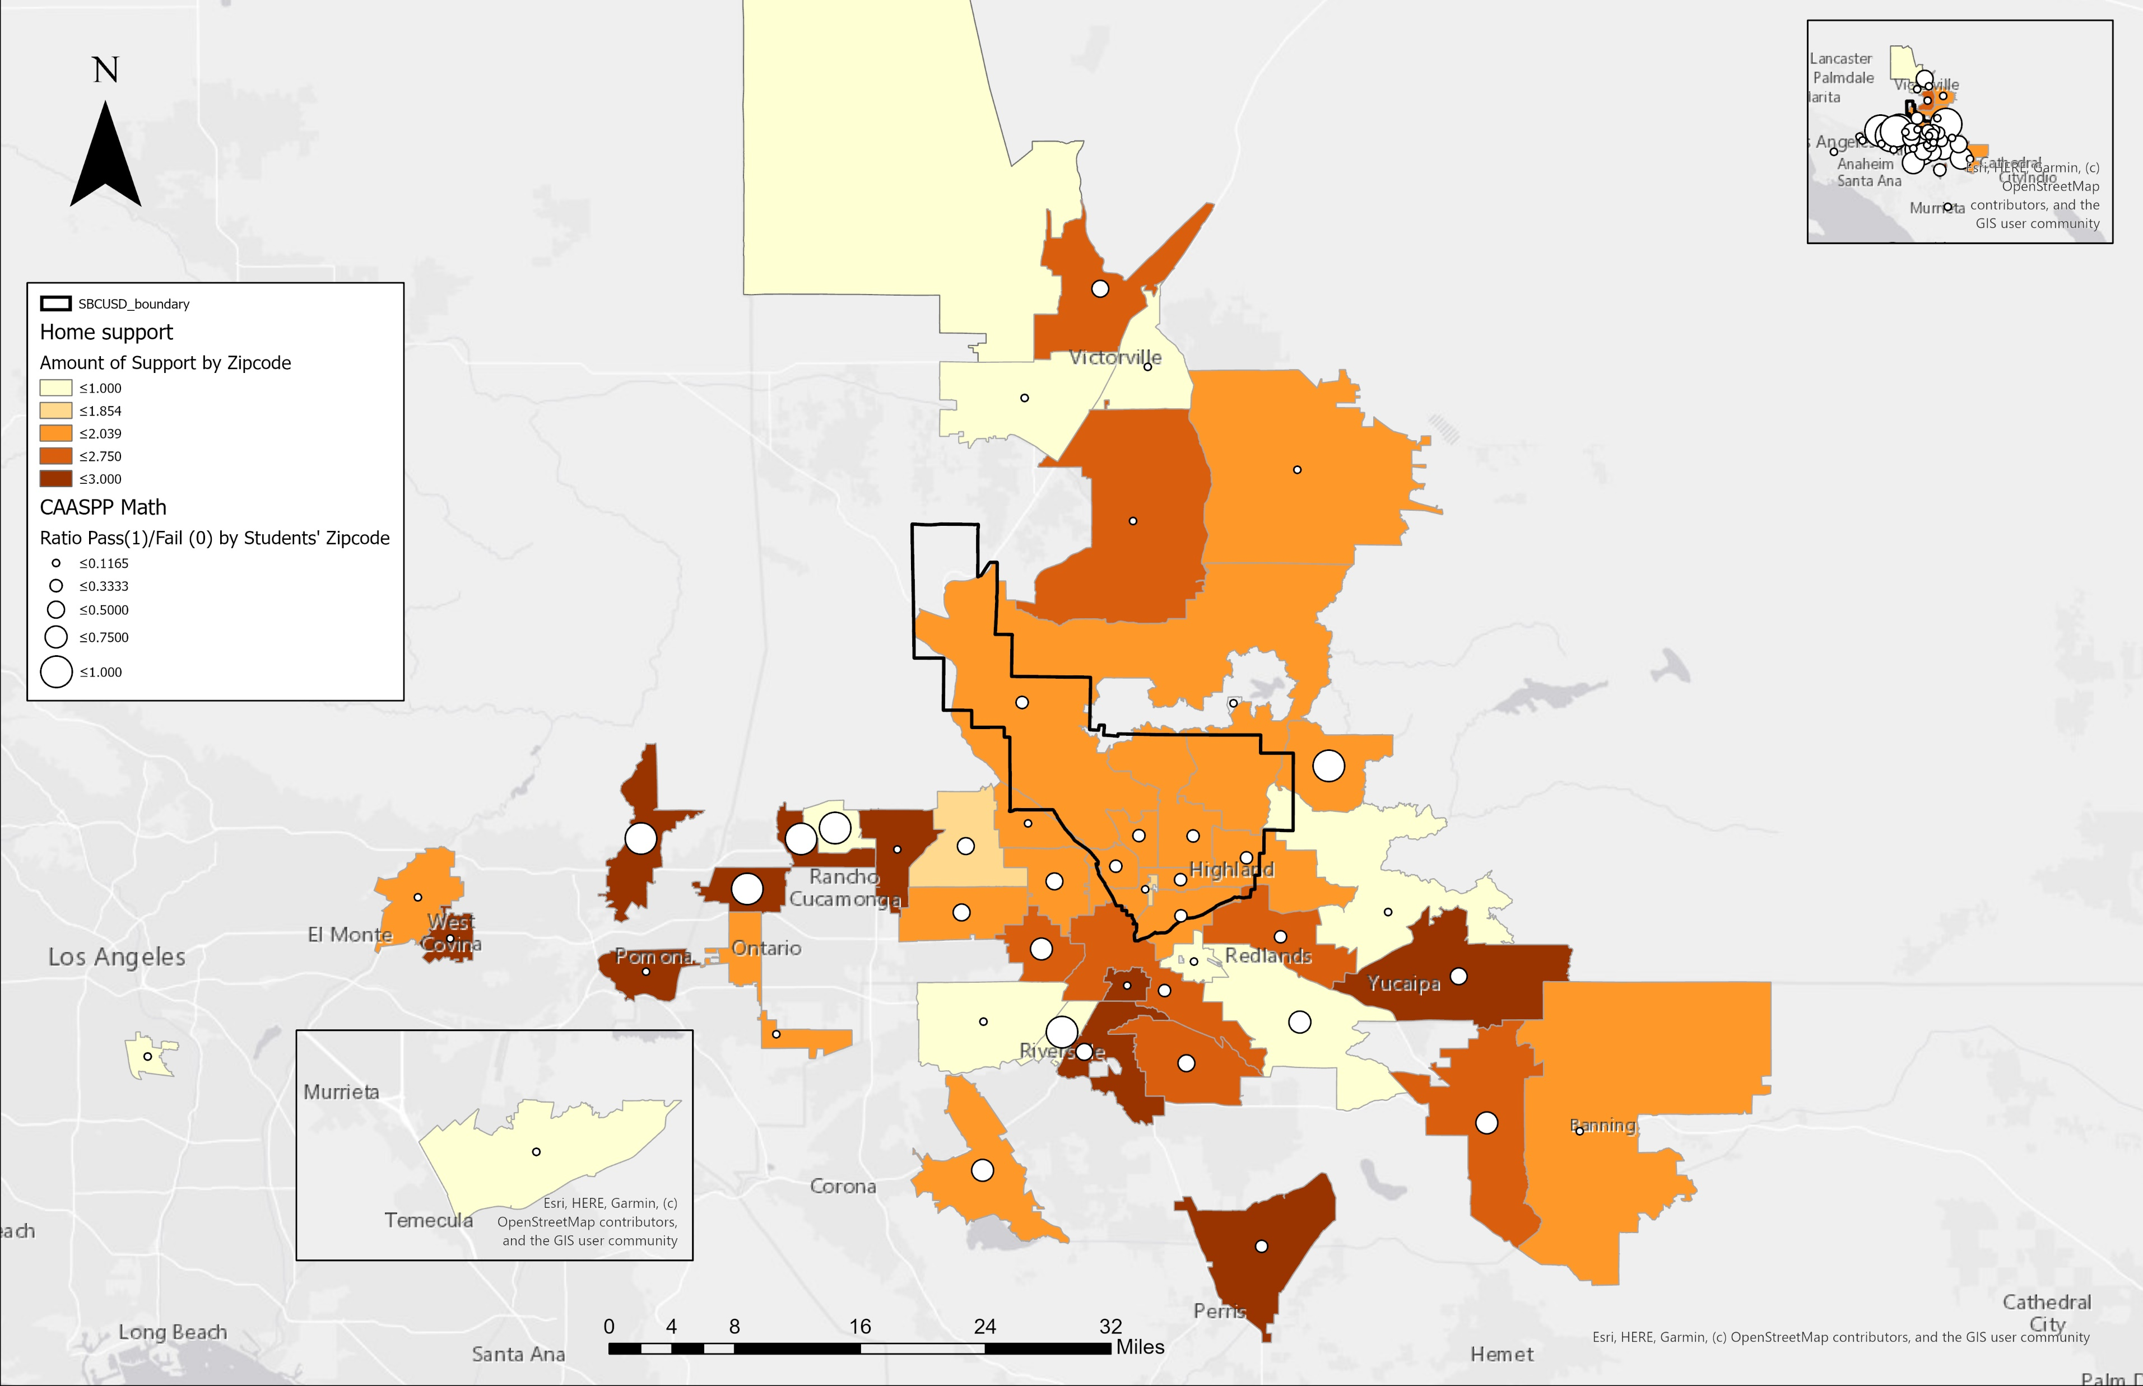
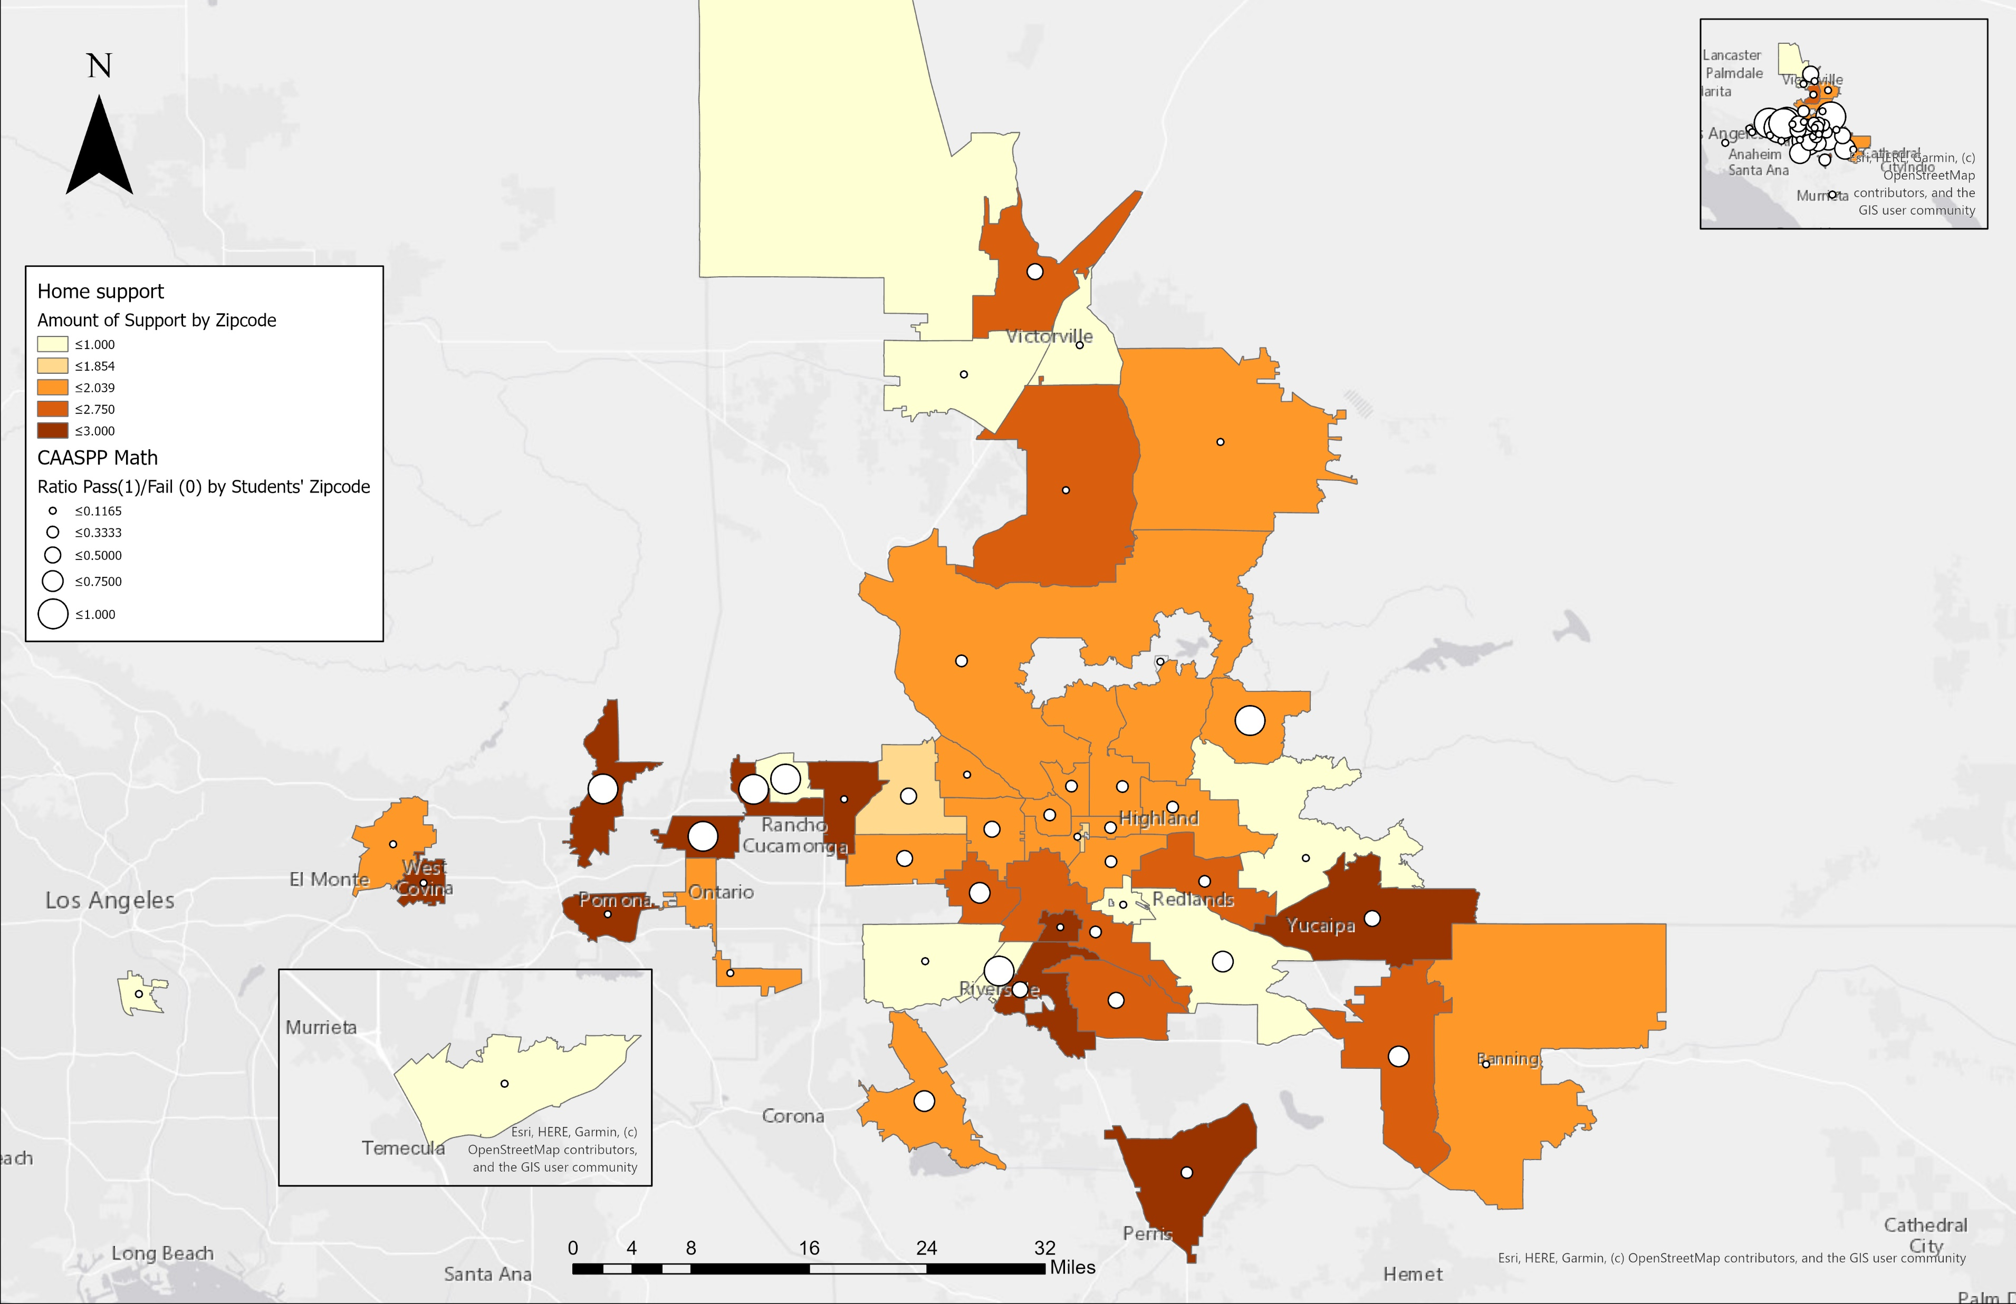
Home support and Math Test Scores
Notes:
Math test scores.

Slide 35
Table 1: Descriptive Statistics
 |  |  | All Students (n = 16,422) |  | CAASP English |  | CAASP Math
Characteristics | n (%) | M | SD | Range | Standard Met n (%) | Standard Not Met n (%) | Standard Met n (%) | Standard Not Met n (%)
Age |  | 13.29 | 2.18 | 9.8 – 19.6
Gender
Male | 8383 (51.05) |  |  |  | 3,178 (44.48) | 5,270 (56.13) | 2,152 (50.41) | 6,201 (51.25)
Female | 8039 (48.95) |  |  |  | 3,996 (55.52) | 4,041 (43.87) | 2117 (49.59) | 5,899 (48.75)
Race/Ethnicity
African Americans | 1488 (9.10) |  |  |  | 518 (34.81) | 970 (65.19) | 235 (15.82) | 1,250 (84.18)
Hispanics | 12,972 (79.32) |  |  |  | 5,647 (43.53) | 7,325 (56.47) | 3,337 (25.69) | 9,650 (74.31)
Other Minorities | 1,067 (6.52) |  |  |  | 510 (47.80) | 557 (52.20) | 371 (34.74) | 697 (65.26)
Whites | 828 (5.06) |  |  |  | 469 (56.64) | 359 (43.36) | 326 (39.32) | 503 (60.68)
Low SES status
Yes | 13,952 (85.31) |  |  |  | 5,803 (41.59) | 8,149 (58.41) | 3,447 (24.69) | 10,515 (75.31)
No | 2403 (14.68) |  |  |  | 1,341 (55.81) | 1,062 (44.19) | 822 (34.15) | 1,585 (65.85)
Grade level
4 | 2,823 (17.26) |  |  |  | 1,084 (38.40) | 1739 (61.60) | 859 (30.36) | 1,970 (69.64)
5 | 3,050 (18.65) |  |  |  | 1,243 (40.75) | 1,807 (59.25) | 649 (21.25) | 2,405 (78.75)
6 | 2,957 (18.08) |  |  |  | 1,274 (43.08) | 1,683 (56.92) | 847 (28.62) | 2,112 (71.38)
7 | 2,761 (16.88) |  |  |  | 1,250 (45.27) | 1,511 (54.73) | 760 (27.50) | 2,004 (72.50)
8 | 2,498 (15.27) |  |  |  | 1,106 (44.28) | 1,392 (55.72) | 682 (27.32) | 1,814 (72.68)
11 | 2,266 (13.86) |  |  |  | 1,187 (52.38) | 1,079 (47.62) | 472 (20.82) | 1,795 (79.18)
All Students | 16,422 |  |  |  | 7,144 (43.68) | 9,211 (56.31) | 4,269 (26.08) | 12,100 (73.92)
Notes:
Now for descriptive statistics, characteristics are also divided by English and Math outcomes that have standard met which indicates passing and standard not met which indicates failing.

Slide 36
Table 1: Descriptive Statistics
 |  |  | All Students (n = 16,422) |  | CAASP English |  | CAASP Math
Characteristics | n (%) | M | SD | Range | Standard Met n (%) | Standard Not Met n (%) | Standard Met n (%) | Standard Not Met n (%)
Age |  | 13.29 | 2.18 | 9.8 – 19.6
Gender
Male | 8383 (51.05) |  |  |  | 3,178 (44.48) | 5,270 (56.13) | 2,152 (50.41) | 6,201 (51.25)
Female | 8039 (48.95) |  |  |  | 3,996 (55.52) | 4,041 (43.87) | 2117 (49.59) | 5,899 (48.75)
Race/Ethnicity
African Americans | 1488 (9.10) |  |  |  | 518 (34.81) | 970 (65.19) | 235 (15.82) | 1,250 (84.18)
Hispanics | 12,972 (79.32) |  |  |  | 5,647 (43.53) | 7,325 (56.47) | 3,337 (25.69) | 9,650 (74.31)
Other Minorities | 1,067 (6.52) |  |  |  | 510 (47.80) | 557 (52.20) | 371 (34.74) | 697 (65.26)
Whites | 828 (5.06) |  |  |  | 469 (56.64) | 359 (43.36) | 326 (39.32) | 503 (60.68)
Low SES status
Yes | 13,952 (85.31) |  |  |  | 5,803 (41.59) | 8,149 (58.41) | 3,447 (24.69) | 10,515 (75.31)
No | 2403 (14.68) |  |  |  | 1,341 (55.81) | 1,062 (44.19) | 822 (34.15) | 1,585 (65.85)
Grade level
4 | 2,823 (17.26) |  |  |  | 1,084 (38.40) | 1739 (61.60) | 859 (30.36) | 1,970 (69.64)
5 | 3,050 (18.65) |  |  |  | 1,243 (40.75) | 1,807 (59.25) | 649 (21.25) | 2,405 (78.75)
6 | 2,957 (18.08) |  |  |  | 1,274 (43.08) | 1,683 (56.92) | 847 (28.62) | 2,112 (71.38)
7 | 2,761 (16.88) |  |  |  | 1,250 (45.27) | 1,511 (54.73) | 760 (27.50) | 2,004 (72.50)
8 | 2,498 (15.27) |  |  |  | 1,106 (44.28) | 1,392 (55.72) | 682 (27.32) | 1,814 (72.68)
11 | 2,266 (13.86) |  |  |  | 1,187 (52.38) | 1,079 (47.62) | 472 (20.82) | 1,795 (79.18)
All Students | 16,422 |  |  |  | 7,144 (43.68) | 9,211 (56.31) | 4,269 (26.08) | 12,100 (73.92)
Notes:
Age range, we see that individuals are about 9 to 19 years old.

Slide 37
Table 1: Descriptive Statistics
 |  |  | All Students (n = 16,422) |  | CAASP English |  | CAASP Math
Characteristics | n (%) | M | SD | Range | Standard Met n (%) | Standard Not Met n (%) | Standard Met n (%) | Standard Not Met n (%)
Age |  | 13.29 | 2.18 | 9.8 – 19.6
Gender
Male | 8383 (51.05) |  |  |  | 3,178 (44.48) | 5,270 (56.13) | 2,152 (50.41) | 6,201 (51.25)
Female | 8039 (48.95) |  |  |  | 3,996 (55.52) | 4,041 (43.87) | 2117 (49.59) | 5,899 (48.75)
Race/Ethnicity
African Americans | 1488 (9.10) |  |  |  | 518 (34.81) | 970 (65.19) | 235 (15.82) | 1,250 (84.18)
Hispanics | 12,972 (79.32) |  |  |  | 5,647 (43.53) | 7,325 (56.47) | 3,337 (25.69) | 9,650 (74.31)
Other Minorities | 1,067 (6.52) |  |  |  | 510 (47.80) | 557 (52.20) | 371 (34.74) | 697 (65.26)
Whites | 828 (5.06) |  |  |  | 469 (56.64) | 359 (43.36) | 326 (39.32) | 503 (60.68)
Low SES status
Yes | 13,952 (85.31) |  |  |  | 5,803 (41.59) | 8,149 (58.41) | 3,447 (24.69) | 10,515 (75.31)
No | 2403 (14.68) |  |  |  | 1,341 (55.81) | 1,062 (44.19) | 822 (34.15) | 1,585 (65.85)
Grade level
4 | 2,823 (17.26) |  |  |  | 1,084 (38.40) | 1739 (61.60) | 859 (30.36) | 1,970 (69.64)
5 | 3,050 (18.65) |  |  |  | 1,243 (40.75) | 1,807 (59.25) | 649 (21.25) | 2,405 (78.75)
6 | 2,957 (18.08) |  |  |  | 1,274 (43.08) | 1,683 (56.92) | 847 (28.62) | 2,112 (71.38)
7 | 2,761 (16.88) |  |  |  | 1,250 (45.27) | 1,511 (54.73) | 760 (27.50) | 2,004 (72.50)
8 | 2,498 (15.27) |  |  |  | 1,106 (44.28) | 1,392 (55.72) | 682 (27.32) | 1,814 (72.68)
11 | 2,266 (13.86) |  |  |  | 1,187 (52.38) | 1,079 (47.62) | 472 (20.82) | 1,795 (79.18)
All Students | 16,422 |  |  |  | 7,144 (43.68) | 9,211 (56.31) | 4,269 (26.08) | 12,100 (73.92)
Notes:
For Gender, we see that Males have a higher pass percentage compared to females for the math section.
However, as you can see, Females do quite better than males in the English test.

Slide 38
Table 1: Descriptive Statistics
 |  |  | All Students (n = 16,422) |  | CAASP English |  | CAASP Math
Characteristics | n (%) | M | SD | Range | Standard Met n (%) | Standard Not Met n (%) | Standard Met n (%) | Standard Not Met n (%)
Age |  | 13.29 | 2.18 | 9.8 – 19.6
Gender
Male | 8383 (51.05) |  |  |  | 3,178 (44.48) | 5,270 (56.13) | 2,152 (50.41) | 6,201 (51.25)
Female | 8039 (48.95) |  |  |  | 3,996 (55.52) | 4,041 (43.87) | 2117 (49.59) | 5,899 (48.75)
Race/Ethnicity
African Americans | 1488 (9.10) |  |  |  | 518 (34.81) | 970 (65.19) | 235 (15.82) | 1,250 (84.18)
Hispanics | 12,972 (79.32) |  |  |  | 5,647 (43.53) | 7,325 (56.47) | 3,337 (25.69) | 9,650 (74.31)
Other Minorities | 1,067 (6.52) |  |  |  | 510 (47.80) | 557 (52.20) | 371 (34.74) | 697 (65.26)
Whites | 828 (5.06) |  |  |  | 469 (56.64) | 359 (43.36) | 326 (39.32) | 503 (60.68)
Low SES status
Yes | 13,952 (85.31) |  |  |  | 5,803 (41.59) | 8,149 (58.41) | 3,447 (24.69) | 10,515 (75.31)
No | 2403 (14.68) |  |  |  | 1,341 (55.81) | 1,062 (44.19) | 822 (34.15) | 1,585 (65.85)
Grade level
4 | 2,823 (17.26) |  |  |  | 1,084 (38.40) | 1739 (61.60) | 859 (30.36) | 1,970 (69.64)
5 | 3,050 (18.65) |  |  |  | 1,243 (40.75) | 1,807 (59.25) | 649 (21.25) | 2,405 (78.75)
6 | 2,957 (18.08) |  |  |  | 1,274 (43.08) | 1,683 (56.92) | 847 (28.62) | 2,112 (71.38)
7 | 2,761 (16.88) |  |  |  | 1,250 (45.27) | 1,511 (54.73) | 760 (27.50) | 2,004 (72.50)
8 | 2,498 (15.27) |  |  |  | 1,106 (44.28) | 1,392 (55.72) | 682 (27.32) | 1,814 (72.68)
11 | 2,266 (13.86) |  |  |  | 1,187 (52.38) | 1,079 (47.62) | 472 (20.82) | 1,795 (79.18)
All Students | 16,422 |  |  |  | 7,144 (43.68) | 9,211 (56.31) | 4,269 (26.08) | 12,100 (73.92)
Notes:
In terms of Race,
Whites do better than other racial groups in both english and math.
In comparison to Whites, African Americans perform the worst academically in both test.

Slide 39
Table 1: Descriptive Statistics
 |  |  | All Students (n = 16,422) |  | CAASP English |  | CAASP Math
Characteristics | n (%) | M | SD | Range | Standard Met n (%) | Standard Not Met n (%) | Standard Met n (%) | Standard Not Met n (%)
Age |  | 13.29 | 2.18 | 9.8 – 19.6
Gender
Male | 8383 (51.05) |  |  |  | 3,178 (44.48) | 5,270 (56.13) | 2,152 (50.41) | 6,201 (51.25)
Female | 8039 (48.95) |  |  |  | 3,996 (55.52) | 4,041 (43.87) | 2117 (49.59) | 5,899 (48.75)
Race/Ethnicity
African Americans | 1488 (9.10) |  |  |  | 518 (34.81) | 970 (65.19) | 235 (15.82) | 1,250 (84.18)
Hispanics | 12,972 (79.32) |  |  |  | 5,647 (43.53) | 7,325 (56.47) | 3,337 (25.69) | 9,650 (74.31)
Other Minorities | 1,067 (6.52) |  |  |  | 510 (47.80) | 557 (52.20) | 371 (34.74) | 697 (65.26)
Whites | 828 (5.06) |  |  |  | 469 (56.64) | 359 (43.36) | 326 (39.32) | 503 (60.68)
Low SES status
Yes | 13,952 (85.31) |  |  |  | 5,803 (41.59) | 8,149 (58.41) | 3,447 (24.69) | 10,515 (75.31)
No | 2403 (14.68) |  |  |  | 1,341 (55.81) | 1,062 (44.19) | 822 (34.15) | 1,585 (65.85)
Grade level
4 | 2,823 (17.26) |  |  |  | 1,084 (38.40) | 1739 (61.60) | 859 (30.36) | 1,970 (69.64)
5 | 3,050 (18.65) |  |  |  | 1,243 (40.75) | 1,807 (59.25) | 649 (21.25) | 2,405 (78.75)
6 | 2,957 (18.08) |  |  |  | 1,274 (43.08) | 1,683 (56.92) | 847 (28.62) | 2,112 (71.38)
7 | 2,761 (16.88) |  |  |  | 1,250 (45.27) | 1,511 (54.73) | 760 (27.50) | 2,004 (72.50)
8 | 2,498 (15.27) |  |  |  | 1,106 (44.28) | 1,392 (55.72) | 682 (27.32) | 1,814 (72.68)
11 | 2,266 (13.86) |  |  |  | 1,187 (52.38) | 1,079 (47.62) | 472 (20.82) | 1,795 (79.18)
All Students | 16,422 |  |  |  | 7,144 (43.68) | 9,211 (56.31) | 4,269 (26.08) | 12,100 (73.92)
Notes:
For Low SES status,
Individuals who are Yes to Low SES do worst than individual who are labeled No to Low SES in both English and math test

Slide 40
Table 1: Descriptive Statistics
 |  |  | All Students (n = 16,422) |  | CAASP English |  | CAASP Math
Characteristics | n (%) | M | SD | Range | Standard Met n (%) | Standard Not Met n (%) | Standard Met n (%) | Standard Not Met n (%)
Age |  | 13.29 | 2.18 | 9.8 – 19.6
Gender
Male | 8383 (51.05) |  |  |  | 3,178 (44.48) | 5,270 (56.13) | 2,152 (50.41) | 6,201 (51.25)
Female | 8039 (48.95) |  |  |  | 3,996 (55.52) | 4,041 (43.87) | 2117 (49.59) | 5,899 (48.75)
Race/Ethnicity
African Americans | 1488 (9.10) |  |  |  | 518 (34.81) | 970 (65.19) | 235 (15.82) | 1,250 (84.18)
Hispanics | 12,972 (79.32) |  |  |  | 5,647 (43.53) | 7,325 (56.47) | 3,337 (25.69) | 9,650 (74.31)
Other Minorities | 1,067 (6.52) |  |  |  | 510 (47.80) | 557 (52.20) | 371 (34.74) | 697 (65.26)
Whites | 828 (5.06) |  |  |  | 469 (56.64) | 359 (43.36) | 326 (39.32) | 503 (60.68)
Low SES status
Yes | 13,952 (85.31) |  |  |  | 5,803 (41.59) | 8,149 (58.41) | 3,447 (24.69) | 10,515 (75.31)
No | 2403 (14.68) |  |  |  | 1,341 (55.81) | 1,062 (44.19) | 822 (34.15) | 1,585 (65.85)
Grade level
4 | 2,823 (17.26) |  |  |  | 1,084 (38.40) | 1739 (61.60) | 859 (30.36) | 1,970 (69.64)
5 | 3,050 (18.65) |  |  |  | 1,243 (40.75) | 1,807 (59.25) | 649 (21.25) | 2,405 (78.75)
6 | 2,957 (18.08) |  |  |  | 1,274 (43.08) | 1,683 (56.92) | 847 (28.62) | 2,112 (71.38)
7 | 2,761 (16.88) |  |  |  | 1,250 (45.27) | 1,511 (54.73) | 760 (27.50) | 2,004 (72.50)
8 | 2,498 (15.27) |  |  |  | 1,106 (44.28) | 1,392 (55.72) | 682 (27.32) | 1,814 (72.68)
11 | 2,266 (13.86) |  |  |  | 1,187 (52.38) | 1,079 (47.62) | 472 (20.82) | 1,795 (79.18)
All Students | 16,422 |  |  |  | 7,144 (43.68) | 9,211 (56.31) | 4,269 (26.08) | 12,100 (73.92)
Notes:
For grade level,
11th graders do the best in the english portion of the caasspp while 4th graders do the best in the math portion of caasp test.

Slide 41
Table 1: Descriptive Statistics
 |  |  | All Students (n = 16,422) |  | CAASP English |  | CAASP Math
Characteristics | n (%) | M | SD | Range | Standard Met n (%) | Standard Not Met n (%) | Standard Met n (%) | Standard Not Met n (%)
Age |  | 13.29 | 2.18 | 9.8 – 19.6
Gender
Male | 8383 (51.05) |  |  |  | 3,178 (44.48) | 5,270 (56.13) | 2,152 (50.41) | 6,201 (51.25)
Female | 8039 (48.95) |  |  |  | 3,996 (55.52) | 4,041 (43.87) | 2117 (49.59) | 5,899 (48.75)
Race/Ethnicity
African Americans | 1488 (9.10) |  |  |  | 518 (34.81) | 970 (65.19) | 235 (15.82) | 1,250 (84.18)
Hispanics | 12,972 (79.32) |  |  |  | 5,647 (43.53) | 7,325 (56.47) | 3,337 (25.69) | 9,650 (74.31)
Other Minorities | 1,067 (6.52) |  |  |  | 510 (47.80) | 557 (52.20) | 371 (34.74) | 697 (65.26)
Whites | 828 (5.06) |  |  |  | 469 (56.64) | 359 (43.36) | 326 (39.32) | 503 (60.68)
Low SES status
Yes | 13,952 (85.31) |  |  |  | 5,803 (41.59) | 8,149 (58.41) | 3,447 (24.69) | 10,515 (75.31)
No | 2403 (14.68) |  |  |  | 1,341 (55.81) | 1,062 (44.19) | 822 (34.15) | 1,585 (65.85)
Grade level
4 | 2,823 (17.26) |  |  |  | 1,084 (38.40) | 1739 (61.60) | 859 (30.36) | 1,970 (69.64)
5 | 3,050 (18.65) |  |  |  | 1,243 (40.75) | 1,807 (59.25) | 649 (21.25) | 2,405 (78.75)
6 | 2,957 (18.08) |  |  |  | 1,274 (43.08) | 1,683 (56.92) | 847 (28.62) | 2,112 (71.38)
7 | 2,761 (16.88) |  |  |  | 1,250 (45.27) | 1,511 (54.73) | 760 (27.50) | 2,004 (72.50)
8 | 2,498 (15.27) |  |  |  | 1,106 (44.28) | 1,392 (55.72) | 682 (27.32) | 1,814 (72.68)
11 | 2,266 (13.86) |  |  |  | 1,187 (52.38) | 1,079 (47.62) | 472 (20.82) | 1,795 (79.18)
All Students | 16,422 |  |  |  | 7,144 (43.68) | 9,211 (56.31) | 4,269 (26.08) | 12,100 (73.92)
Notes:
When looking at all students in the district,
We see that only 43% of students passed the english test
While 26% of students passed the math test.

Slide 42
Table 2: Model 1 - Age Range without Grade level
Variable | CAASP English OR ( 95% CI) | P-value | CAASP Math OR (95 % CI) | P-value
Age Range
9 - 11 | 1.00 (REF) |  | 1.00 (REF)
12 - 13 | 1.08 (0.99 - 1.17) | 0.0820 | 1.04 (0.95 - 1.14) | 0.3757
14 - 15 | 1.02 (0.91 - 1.12) | 0.7580 | 0.91 (0.82 - 1.02) | 0.1099
16 - 17 | 1.70 (1.51 - 1.90) | <.0001 | 0.74 (0.65 - 0.85) | <.0001
18 - 19 | 0.54 (0.43 - 0.69) | <.0001 | 0.15 (0.10 - 0.23) | <.0001
Gender
Female | 1.00 (REF) |  | 1.00 (REF)
Male | 0.64 (0.60 – 0.68) | <.0001 | 0.99 (0.92 - 1.07) | 0.8361
Race/Ethnicity
White | 1.00 (REF) |  | 1.00 (REF)
African American | 0.40 (0.34 - 0.49) | <.0001 | 0.30 (0.24 – 0.37) | <.0001
Hispanic | 0.62 (0.53 - 0.72) | <.0001 | 0.57 (0.49 - 0.66) | <.0001
Other Minorities | 0.73 (0.60 – 0.68) | 0.0014 | 0.84 (0.69 – 1.02) | 0.0837
Low SES Status
No | 1.00 (REF) |  | 1.00 (REF)
Yes | 0.62 (0.60 – 0.68) | <.0001 | 0.61 (0.55 – 0.67) | <.0001
Home Support
Little Support | 1.00 (REF) |  | 1.00 (REF)
Moderate Support | 1.38 (1.24 – 1.53) | <.0001 | 1.33 ( 1.18 – 1.51) | <.0001
Semi-Full Support | 1.56 (1.40 – 1.74) | <.0001 | 1.54 (1.36 – 1.74) | <.0001
Full Support | 1.84 (1.64 – 2.06) | <.0001 | 1.71 (1.50 – 1.94) | <.0001
Outside Support
Little Support | 1.00 (REF) |  | 1.00 (REF)
Moderate Support | 0.79 (0.71 – 0.89) | <.0001 | 0.87 (0.76 – 0.98) | 0.0238
Semi-Full | 0.76 (0.69 - 0.85) | <.0001 | 0.77 (0.69 – 0.87) | <.0001
Full Support | 0.85 (0.76 - 0.95) | 0.0029 | 0.81 (0.72 – 0.91) | 0.0006
School Support
Very Little Support | 1.00 (REF) |  | 1.00 (REF)
Little Support | 1.21 (1.10 - 1.37) | 0.0037 | 1.19 (1.03 – 1.37) | 0.0204
Moderate Support | 1.24 (1.11 – 1.34) | 0.0002 | 1.21 (1.07 – 1.38) | 0.0036
Semi-Full Support | 1.32 (1.17 – 1.15) | <.0001 | 1.29 (1.12 – 1.49) | 0.0005
Full Support | 1.07 (0.94 – 1.21) | 0.3150 | 1.16 (1.01 – 1.35) | 0.0416
Notes:
Table 2 indicated our model without gra
Dose Response → trend P → one p is the slope of the line

Slide 43
Table 2: Model 1 - Age Range without Grade level
Variable | CAASP English OR ( 95% CI) | P-value | CAASP Math OR (95 % CI) | P-value
Age Range
9 - 11 | 1.00 (REF) |  | 1.00 (REF)
12 - 13 | 1.08 (0.99 - 1.17) | 0.0820 | 1.04 (0.95 - 1.14) | 0.3757
14 - 15 | 1.02 (0.91 - 1.12) | 0.7580 | 0.91 (0.82 - 1.02) | 0.1099
16 - 17 | 1.70 (1.51 - 1.90) | <.0001 | 0.74 (0.65 - 0.85) | <.0001
18 - 19 | 0.54 (0.43 - 0.69) | <.0001 | 0.15 (0.10 - 0.23) | <.0001
Gender
Female | 1.00 (REF) |  | 1.00 (REF)
Male | 0.64 (0.60 – 0.68) | <.0001 | 0.99 (0.92 - 1.07) | 0.8361
Race/Ethnicity
White | 1.00 (REF) |  | 1.00 (REF)
African American | 0.40 (0.34 - 0.49) | <.0001 | 0.30 (0.24 – 0.37) | <.0001
Hispanic | 0.62 (0.53 - 0.72) | <.0001 | 0.57 (0.49 - 0.66) | <.0001
Other Minorities | 0.73 (0.60 – 0.68) | 0.0014 | 0.84 (0.69 – 1.02) | 0.0837
Low SES Status
No | 1.00 (REF) |  | 1.00 (REF)
Yes | 0.62 (0.60 – 0.68) | <.0001 | 0.61 (0.55 – 0.67) | <.0001
Home Support
Little Support | 1.00 (REF) |  | 1.00 (REF)
Moderate Support | 1.38 (1.24 – 1.53) | <.0001 | 1.33 ( 1.18 – 1.51) | <.0001
Semi-Full Support | 1.56 (1.40 – 1.74) | <.0001 | 1.54 (1.36 – 1.74) | <.0001
Full Support | 1.84 (1.64 – 2.06) | <.0001 | 1.71 (1.50 – 1.94) | <.0001
Outside Support
Little Support | 1.00 (REF) |  | 1.00 (REF)
Moderate Support | 0.79 (0.71 – 0.89) | <.0001 | 0.87 (0.76 – 0.98) | 0.0238
Semi-Full | 0.76 (0.69 - 0.85) | <.0001 | 0.77 (0.69 – 0.87) | <.0001
Full Support | 0.85 (0.76 - 0.95) | 0.0029 | 0.81 (0.72 – 0.91) | 0.0006
School Support
Very Little Support | 1.00 (REF) |  | 1.00 (REF)
Little Support | 1.21 (1.10 - 1.37) | 0.0037 | 1.19 (1.03 – 1.37) | 0.0204
Moderate Support | 1.24 (1.11 – 1.34) | 0.0002 | 1.21 (1.07 – 1.38) | 0.0036
Semi-Full Support | 1.32 (1.17 – 1.15) | <.0001 | 1.29 (1.12 – 1.49) | 0.0005
Full Support | 1.07 (0.94 – 1.21) | 0.3150 | 1.16 (1.01 – 1.35) | 0.0416
Notes:
When looking at age range compared to the reference group of 9-11 , We can see for ages 16-17 in terms of the english test, they have increased odds for passing the English test since the
Odds ratio is more than 1, 1.70 and significant or having an effect of passing the test since the p-value is less than .05, .0001.
However, for age-range , math is found to be insignificant towards odds of passing the test in reference to age range 9-11.

Slide 44
Table 2: Model 1 - Age Range without Grade level
Variable | CAASP English OR ( 95% CI) | P-value | CAASP Math OR (95 % CI) | P-value
Age Range
9 - 11 | 1.00 (REF) |  | 1.00 (REF)
12 - 13 | 1.08 (0.99 - 1.17) | 0.0820 | 1.04 (0.95 - 1.14) | 0.3757
14 - 15 | 1.02 (0.91 - 1.12) | 0.7580 | 0.91 (0.82 - 1.02) | 0.1099
16 - 17 | 1.70 (1.51 - 1.90) | <.0001 | 0.74 (0.65 - 0.85) | <.0001
18 - 19 | 0.54 (0.43 - 0.69) | <.0001 | 0.15 (0.10 - 0.23) | <.0001
Gender
Female | 1.00 (REF) |  | 1.00 (REF)
Male | 0.64 (0.60 – 0.68) | <.0001 | 0.99 (0.92 - 1.07) | 0.8361
Race/Ethnicity
White | 1.00 (REF) |  | 1.00 (REF)
African American | 0.40 (0.34 - 0.49) | <.0001 | 0.30 (0.24 – 0.37) | <.0001
Hispanic | 0.62 (0.53 - 0.72) | <.0001 | 0.57 (0.49 - 0.66) | <.0001
Other Minorities | 0.73 (0.60 – 0.68) | 0.0014 | 0.84 (0.69 – 1.02) | 0.0837
Low SES Status
No | 1.00 (REF) |  | 1.00 (REF)
Yes | 0.62 (0.60 – 0.68) | <.0001 | 0.61 (0.55 – 0.67) | <.0001
Home Support
Little Support | 1.00 (REF) |  | 1.00 (REF)
Moderate Support | 1.38 (1.24 – 1.53) | <.0001 | 1.33 ( 1.18 – 1.51) | <.0001
Semi-Full Support | 1.56 (1.40 – 1.74) | <.0001 | 1.54 (1.36 – 1.74) | <.0001
Full Support | 1.84 (1.64 – 2.06) | <.0001 | 1.71 (1.50 – 1.94) | <.0001
Outside Support
Little Support | 1.00 (REF) |  | 1.00 (REF)
Moderate Support | 0.79 (0.71 – 0.89) | <.0001 | 0.87 (0.76 – 0.98) | 0.0238
Semi-Full | 0.76 (0.69 - 0.85) | <.0001 | 0.77 (0.69 – 0.87) | <.0001
Full Support | 0.85 (0.76 - 0.95) | 0.0029 | 0.81 (0.72 – 0.91) | 0.0006
School Support
Very Little Support | 1.00 (REF) |  | 1.00 (REF)
Little Support | 1.21 (1.10 - 1.37) | 0.0037 | 1.19 (1.03 – 1.37) | 0.0204
Moderate Support | 1.24 (1.11 – 1.34) | 0.0002 | 1.21 (1.07 – 1.38) | 0.0036
Semi-Full Support | 1.32 (1.17 – 1.15) | <.0001 | 1.29 (1.12 – 1.49) | 0.0005
Full Support | 1.07 (0.94 – 1.21) | 0.3150 | 1.16 (1.01 – 1.35) | 0.0416
Notes:
In terms of gender,
Compared to females,
Males is significant however, there is less odds for passing the english test.
For the math portion, it is not significant.

Slide 45
Table 2: Model 1 - Age Range without Grade level
Variable | CAASP English OR ( 95% CI) | P-value | CAASP Math OR (95 % CI) | P-value
Age Range
9 - 11 | 1.00 (REF) |  | 1.00 (REF)
12 - 13 | 1.08 (0.99 - 1.17) | 0.0820 | 1.04 (0.95 - 1.14) | 0.3757
14 - 15 | 1.02 (0.91 - 1.12) | 0.7580 | 0.91 (0.82 - 1.02) | 0.1099
16 - 17 | 1.70 (1.51 - 1.90) | <.0001 | 0.74 (0.65 - 0.85) | <.0001
18 - 19 | 0.54 (0.43 - 0.69) | <.0001 | 0.15 (0.10 - 0.23) | <.0001
Gender
Female | 1.00 (REF) |  | 1.00 (REF)
Male | 0.64 (0.60 – 0.68) | <.0001 | 0.99 (0.92 - 1.07) | 0.8361
Race/Ethnicity
White | 1.00 (REF) |  | 1.00 (REF)
African American | 0.40 (0.34 - 0.49) | <.0001 | 0.30 (0.24 – 0.37) | <.0001
Hispanic | 0.62 (0.53 - 0.72) | <.0001 | 0.57 (0.49 - 0.66) | <.0001
Other Minorities | 0.73 (0.60 – 0.68) | 0.0014 | 0.84 (0.69 – 1.02) | 0.0837
Low SES Status
No | 1.00 (REF) |  | 1.00 (REF)
Yes | 0.62 (0.60 – 0.68) | <.0001 | 0.61 (0.55 – 0.67) | <.0001
Home Support
Little Support | 1.00 (REF) |  | 1.00 (REF)
Moderate Support | 1.38 (1.24 – 1.53) | <.0001 | 1.33 ( 1.18 – 1.51) | <.0001
Semi-Full Support | 1.56 (1.40 – 1.74) | <.0001 | 1.54 (1.36 – 1.74) | <.0001
Full Support | 1.84 (1.64 – 2.06) | <.0001 | 1.71 (1.50 – 1.94) | <.0001
Outside Support
Little Support | 1.00 (REF) |  | 1.00 (REF)
Moderate Support | 0.79 (0.71 – 0.89) | <.0001 | 0.87 (0.76 – 0.98) | 0.0238
Semi-Full | 0.76 (0.69 - 0.85) | <.0001 | 0.77 (0.69 – 0.87) | <.0001
Full Support | 0.85 (0.76 - 0.95) | 0.0029 | 0.81 (0.72 – 0.91) | 0.0006
School Support
Very Little Support | 1.00 (REF) |  | 1.00 (REF)
Little Support | 1.21 (1.10 - 1.37) | 0.0037 | 1.19 (1.03 – 1.37) | 0.0204
Moderate Support | 1.24 (1.11 – 1.34) | 0.0002 | 1.21 (1.07 – 1.38) | 0.0036
Semi-Full Support | 1.32 (1.17 – 1.15) | <.0001 | 1.29 (1.12 – 1.49) | 0.0005
Full Support | 1.07 (0.94 – 1.21) | 0.3150 | 1.16 (1.01 – 1.35) | 0.0416
Notes:
In terms of race compared to whites
for the English portion, all minority groups are significant however, there are no increase odds for passing the test.
For the math portion only African Americans and Hispanics are significant but do not have increase odds for passing the test.

Slide 46
Table 2: Model 1 - Age Range without Grade level
Variable | CAASP English OR ( 95% CI) | P-value | CAASP Math OR (95 % CI) | P-value
Age Range
9 - 11 | 1.00 (REF) |  | 1.00 (REF)
12 - 13 | 1.08 (0.99 - 1.17) | 0.0820 | 1.04 (0.95 - 1.14) | 0.3757
14 - 15 | 1.02 (0.91 - 1.12) | 0.7580 | 0.91 (0.82 - 1.02) | 0.1099
16 - 17 | 1.70 (1.51 - 1.90) | <.0001 | 0.74 (0.65 - 0.85) | <.0001
18 - 19 | 0.54 (0.43 - 0.69) | <.0001 | 0.15 (0.10 - 0.23) | <.0001
Gender
Female | 1.00 (REF) |  | 1.00 (REF)
Male | 0.64 (0.60 – 0.68) | <.0001 | 0.99 (0.92 - 1.07) | 0.8361
Race/Ethnicity
White | 1.00 (REF) |  | 1.00 (REF)
African American | 0.40 (0.34 - 0.49) | <.0001 | 0.30 (0.24 – 0.37) | <.0001
Hispanic | 0.62 (0.53 - 0.72) | <.0001 | 0.57 (0.49 - 0.66) | <.0001
Other Minorities | 0.73 (0.60 – 0.68) | 0.0014 | 0.84 (0.69 – 1.02) | 0.0837
Low SES Status
No | 1.00 (REF) |  | 1.00 (REF)
Yes | 0.62 (0.60 – 0.68) | <.0001 | 0.61 (0.55 – 0.67) | <.0001
Home Support
Little Support | 1.00 (REF) |  | 1.00 (REF)
Moderate Support | 1.38 (1.24 – 1.53) | <.0001 | 1.33 ( 1.18 – 1.51) | <.0001
Semi-Full Support | 1.56 (1.40 – 1.74) | <.0001 | 1.54 (1.36 – 1.74) | <.0001
Full Support | 1.84 (1.64 – 2.06) | <.0001 | 1.71 (1.50 – 1.94) | <.0001
Outside Support
Little Support | 1.00 (REF) |  | 1.00 (REF)
Moderate Support | 0.79 (0.71 – 0.89) | <.0001 | 0.87 (0.76 – 0.98) | 0.0238
Semi-Full | 0.76 (0.69 - 0.85) | <.0001 | 0.77 (0.69 – 0.87) | <.0001
Full Support | 0.85 (0.76 - 0.95) | 0.0029 | 0.81 (0.72 – 0.91) | 0.0006
School Support
Very Little Support | 1.00 (REF) |  | 1.00 (REF)
Little Support | 1.21 (1.10 - 1.37) | 0.0037 | 1.19 (1.03 – 1.37) | 0.0204
Moderate Support | 1.24 (1.11 – 1.34) | 0.0002 | 1.21 (1.07 – 1.38) | 0.0036
Semi-Full Support | 1.32 (1.17 – 1.15) | <.0001 | 1.29 (1.12 – 1.49) | 0.0005
Full Support | 1.07 (0.94 – 1.21) | 0.3150 | 1.16 (1.01 – 1.35) | 0.0416
Notes:
For Low SES status
In comparison to No to low SES.
We see that both English and math are significant but both do not have increase odds for passing

Slide 47
Table 2: Model 1 - Age Range without Grade level
Variable | CAASP English OR ( 95% CI) | P-value | CAASP Math OR (95 % CI) | P-value
Age Range
9 - 11 | 1.00 (REF) |  | 1.00 (REF)
12 - 13 | 1.08 (0.99 - 1.17) | 0.0820 | 1.04 (0.95 - 1.14) | 0.3757
14 - 15 | 1.02 (0.91 - 1.12) | 0.7580 | 0.91 (0.82 - 1.02) | 0.1099
16 - 17 | 1.70 (1.51 - 1.90) | <.0001 | 0.74 (0.65 - 0.85) | <.0001
18 - 19 | 0.54 (0.43 - 0.69) | <.0001 | 0.15 (0.10 - 0.23) | <.0001
Gender
Female | 1.00 (REF) |  | 1.00 (REF)
Male | 0.64 (0.60 – 0.68) | <.0001 | 0.99 (0.92 - 1.07) | 0.8361
Race/Ethnicity
White | 1.00 (REF) |  | 1.00 (REF)
African American | 0.40 (0.34 - 0.49) | <.0001 | 0.30 (0.24 – 0.37) | <.0001
Hispanic | 0.62 (0.53 - 0.72) | <.0001 | 0.57 (0.49 - 0.66) | <.0001
Other Minorities | 0.73 (0.60 – 0.68) | 0.0014 | 0.84 (0.69 – 1.02) | 0.0837
Low SES Status
No | 1.00 (REF) |  | 1.00 (REF)
Yes | 0.62 (0.60 – 0.68) | <.0001 | 0.61 (0.55 – 0.67) | <.0001
Home Support
Little Support | 1.00 (REF) |  | 1.00 (REF)
Moderate Support | 1.38 (1.24 – 1.53) | <.0001 | 1.33 ( 1.18 – 1.51) | <.0001
Semi-Full Support | 1.56 (1.40 – 1.74) | <.0001 | 1.54 (1.36 – 1.74) | <.0001
Full Support | 1.84 (1.64 – 2.06) | <.0001 | 1.71 (1.50 – 1.94) | <.0001
Outside Support
Little Support | 1.00 (REF) |  | 1.00 (REF)
Moderate Support | 0.79 (0.71 – 0.89) | <.0001 | 0.87 (0.76 – 0.98) | 0.0238
Semi-Full | 0.76 (0.69 - 0.85) | <.0001 | 0.77 (0.69 – 0.87) | <.0001
Full Support | 0.85 (0.76 - 0.95) | 0.0029 | 0.81 (0.72 – 0.91) | 0.0006
School Support
Very Little Support | 1.00 (REF) |  | 1.00 (REF)
Little Support | 1.21 (1.10 - 1.37) | 0.0037 | 1.19 (1.03 – 1.37) | 0.0204
Moderate Support | 1.24 (1.11 – 1.34) | 0.0002 | 1.21 (1.07 – 1.38) | 0.0036
Semi-Full Support | 1.32 (1.17 – 1.15) | <.0001 | 1.29 (1.12 – 1.49) | 0.0005
Full Support | 1.07 (0.94 – 1.21) | 0.3150 | 1.16 (1.01 – 1.35) | 0.0416
Notes:
In terms of home support
For both english and math,
We see there is significance increasing support.
We can also see that in comparison to little support, more support has increasing odds, to passing both the english and math tests.

Slide 48
Table 2: Model 1 - Age Range without Grade level
Variable | CAASP English OR ( 95% CI) | P-value | CAASP Math OR (95 % CI) | P-value
Age Range
9 - 11 | 1.00 (REF) |  | 1.00 (REF)
12 - 13 | 1.08 (0.99 - 1.17) | 0.0820 | 1.04 (0.95 - 1.14) | 0.3757
14 - 15 | 1.02 (0.91 - 1.12) | 0.7580 | 0.91 (0.82 - 1.02) | 0.1099
16 - 17 | 1.70 (1.51 - 1.90) | <.0001 | 0.74 (0.65 - 0.85) | <.0001
18 - 19 | 0.54 (0.43 - 0.69) | <.0001 | 0.15 (0.10 - 0.23) | <.0001
Gender
Female | 1.00 (REF) |  | 1.00 (REF)
Male | 0.64 (0.60 – 0.68) | <.0001 | 0.99 (0.92 - 1.07) | 0.8361
Race/Ethnicity
White | 1.00 (REF) |  | 1.00 (REF)
African American | 0.40 (0.34 - 0.49) | <.0001 | 0.30 (0.24 – 0.37) | <.0001
Hispanic | 0.62 (0.53 - 0.72) | <.0001 | 0.57 (0.49 - 0.66) | <.0001
Other Minorities | 0.73 (0.60 – 0.68) | 0.0014 | 0.84 (0.69 – 1.02) | 0.0837
Low SES Status
No | 1.00 (REF) |  | 1.00 (REF)
Yes | 0.62 (0.60 – 0.68) | <.0001 | 0.61 (0.55 – 0.67) | <.0001
Home Support
Little Support | 1.00 (REF) |  | 1.00 (REF)
Moderate Support | 1.38 (1.24 – 1.53) | <.0001 | 1.33 ( 1.18 – 1.51) | <.0001
Semi-Full Support | 1.56 (1.40 – 1.74) | <.0001 | 1.54 (1.36 – 1.74) | <.0001
Full Support | 1.84 (1.64 – 2.06) | <.0001 | 1.71 (1.50 – 1.94) | <.0001
Outside Support
Little Support | 1.00 (REF) |  | 1.00 (REF)
Moderate Support | 0.79 (0.71 – 0.89) | <.0001 | 0.87 (0.76 – 0.98) | 0.0238
Semi-Full | 0.76 (0.69 - 0.85) | <.0001 | 0.77 (0.69 – 0.87) | <.0001
Full Support | 0.85 (0.76 - 0.95) | 0.0029 | 0.81 (0.72 – 0.91) | 0.0006
School Support
Very Little Support | 1.00 (REF) |  | 1.00 (REF)
Little Support | 1.21 (1.10 - 1.37) | 0.0037 | 1.19 (1.03 – 1.37) | 0.0204
Moderate Support | 1.24 (1.11 – 1.34) | 0.0002 | 1.21 (1.07 – 1.38) | 0.0036
Semi-Full Support | 1.32 (1.17 – 1.15) | <.0001 | 1.29 (1.12 – 1.49) | 0.0005
Full Support | 1.07 (0.94 – 1.21) | 0.3150 | 1.16 (1.01 – 1.35) | 0.0416
Notes:
However, when looking at outside support than home and school,
There are no increase odds for passing the test

Slide 49
Table 2: Model 1 - Age Range without Grade level
Variable | CAASP English OR ( 95% CI) | P-value | CAASP Math OR (95 % CI) | P-value
Age Range
9 - 11 | 1.00 (REF) |  | 1.00 (REF)
12 - 13 | 1.08 (0.99 - 1.17) | 0.0820 | 1.04 (0.95 - 1.14) | 0.3757
14 - 15 | 1.02 (0.91 - 1.12) | 0.7580 | 0.91 (0.82 - 1.02) | 0.1099
16 - 17 | 1.70 (1.51 - 1.90) | <.0001 | 0.74 (0.65 - 0.85) | <.0001
18 - 19 | 0.54 (0.43 - 0.69) | <.0001 | 0.15 (0.10 - 0.23) | <.0001
Gender
Female | 1.00 (REF) |  | 1.00 (REF)
Male | 0.64 (0.60 – 0.68) | <.0001 | 0.99 (0.92 - 1.07) | 0.8361
Race/Ethnicity
White | 1.00 (REF) |  | 1.00 (REF)
African American | 0.40 (0.34 - 0.49) | <.0001 | 0.30 (0.24 – 0.37) | <.0001
Hispanic | 0.62 (0.53 - 0.72) | <.0001 | 0.57 (0.49 - 0.66) | <.0001
Other Minorities | 0.73 (0.60 – 0.68) | 0.0014 | 0.84 (0.69 – 1.02) | 0.0837
Low SES Status
No | 1.00 (REF) |  | 1.00 (REF)
Yes | 0.62 (0.60 – 0.68) | <.0001 | 0.61 (0.55 – 0.67) | <.0001
Home Support
Little Support | 1.00 (REF) |  | 1.00 (REF)
Moderate Support | 1.38 (1.24 – 1.53) | <.0001 | 1.33 ( 1.18 – 1.51) | <.0001
Semi-Full Support | 1.56 (1.40 – 1.74) | <.0001 | 1.54 (1.36 – 1.74) | <.0001
Full Support | 1.84 (1.64 – 2.06) | <.0001 | 1.71 (1.50 – 1.94) | <.0001
Outside Support
Little Support | 1.00 (REF) |  | 1.00 (REF)
Moderate Support | 0.79 (0.71 – 0.89) | <.0001 | 0.87 (0.76 – 0.98) | 0.0238
Semi-Full | 0.76 (0.69 - 0.85) | <.0001 | 0.77 (0.69 – 0.87) | <.0001
Full Support | 0.85 (0.76 - 0.95) | 0.0029 | 0.81 (0.72 – 0.91) | 0.0006
School Support
Very Little Support | 1.00 (REF) |  | 1.00 (REF)
Little Support | 1.21 (1.10 - 1.37) | 0.0037 | 1.19 (1.03 – 1.37) | 0.0204
Moderate Support | 1.24 (1.11 – 1.34) | 0.0002 | 1.21 (1.07 – 1.38) | 0.0036
Semi-Full Support | 1.32 (1.17 – 1.15) | <.0001 | 1.29 (1.12 – 1.49) | 0.0005
Full Support | 1.07 (0.94 – 1.21) | 0.3150 | 1.16 (1.01 – 1.35) | 0.0416
Notes:
When looking at school support compared to very little support,
We see that little support to semi-full support is significant, however we see that full support is not signicant in the english portion and barely significant in the math portion.
However, atleast we see increasing odds for passing the test for little support to semi-full support categories for school support.

Slide 50
Table 3: Model 2 – Grade level without Age Range
Variable | CAASP English OR ( 95% CI) | P-value | CAASP Math OR (95 % CI) | P-value
Grade Level
4 | 1.00 (REF) |  | 1.00 (REF)
5 | 1.08 (0.97 - 1.21) | 0.1758 | 0.58 (0.52 - 0.661) | <.0001
6 | 1.19 (1.06 - 1.33) | 0.0030 | 0.89 (0.79 - 1.01) | 0.0676
7 | 1.31 (1.17 - 1.47) | <.0001 | 0.86 (0.76 - 0.97) | 0.0175
8 | 1.31 (1.16 - 1.48) | <.0001 | 0.88 (0.78 - 1.00) | 0.0537
11 | 1.61 (1.42 - 1.82) | <.0001 | 0.53 (0.46 - 0.61) | <.0001
Notes:
Table 3 we see Model 2 which indicates grade level without age range.
The reference grade is grade 4.

Slide 51
Table 3: Model 2 – Grade level without Age Range
Variable | CAASP English OR ( 95% CI) | P-value | CAASP Math OR (95 % CI) | P-value
Grade Level
4 | 1.00 (REF) |  | 1.00 (REF)
5 | 1.08 (0.97 - 1.21) | 0.1758 | 0.58 (0.52 - 0.661) | <.0001
6 | 1.19 (1.06 - 1.33) | 0.0030 | 0.89 (0.79 - 1.01) | 0.0676
7 | 1.31 (1.17 - 1.47) | <.0001 | 0.86 (0.76 - 0.97) | 0.0175
8 | 1.31 (1.16 - 1.48) | <.0001 | 0.88 (0.78 - 1.00) | 0.0537
11 | 1.61 (1.42 - 1.82) | <.0001 | 0.53 (0.46 - 0.61) | <.0001
Notes:
For grade 6 in the english portion, it is significant and has increase odds for passing the test as compared to grade 4

Slide 52
Table 3: Model 2 – Grade level without Age Range
Variable | CAASP English OR ( 95% CI) | P-value | CAASP Math OR (95 % CI) | P-value
Grade Level
4 | 1.00 (REF) |  | 1.00 (REF)
5 | 1.08 (0.97 - 1.21) | 0.1758 | 0.58 (0.52 - 0.661) | <.0001
6 | 1.19 (1.06 - 1.33) | 0.0030 | 0.89 (0.79 - 1.01) | 0.0676
7 | 1.31 (1.17 - 1.47) | <.0001 | 0.86 (0.76 - 0.97) | 0.0175
8 | 1.31 (1.16 - 1.48) | <.0001 | 0.88 (0.78 - 1.00) | 0.0537
11 | 1.61 (1.42 - 1.82) | <.0001 | 0.53 (0.46 - 0.61) | <.0001
Notes:
In the English portion, students who are in higher grade levels compared to grade 4,
We see increasing odds for passing the english caasp test.
However, we do not see this trend in the math portion for higher grade levels compared to 4th grade.

Slide 53
DISCUSSION
Notes:
So now we will discuss the results and compare them against the literature.

Slide 54

SPATIAL ANALYSIS
Students who lived outside the SBCUSD boundaries
Inside SBCUSD boundary had increased poverty
Students with better access to healthy foods.
USA National Average crime rate in student living zip code area
Students who are living outside the boundary are receiving more support
Inadequate sample size of students that live outside the boundary to make a conclusion.
Notes:
From our spatial analysis, we saw that students who lived outside the school district boundaries had higher test scores and had more support. We also saw in comparison, students who lived inside the district boundary had increased poverty.
In terms of food environment, better access to health foods have better test scores.Students generally live in areas that have high crime rates than the usa average so it’s hard to distinguish a pattern test scores and crime.
However, these conclusions can not be made Because of the inadequate sample size of students living outside the san Bernardino school district boundary.

Slide 55

Logistic Regression
Age Range (Model 1) and Grade Level (Model 2) are highly correlated with each other
Covariates has very similar results in both models
Students did better on the English test than the Math test.
Individuals who had the least odds of passing
Younger
Male
African American
Early Grade level
Home Support
School Support
Notes:
When looking at our logistic regression results,
We have two models since age range and grade level must be separated to avoid collinearity.
However, the covariates have very similar results. Students did better on the english test than the math test. Individuals who had the least odds of passing were
Younger, Male, African American, and earlier grade level. Home support had significant results towards passing and increasing odds for increasing support for passing the tests.
In terms of school support, full support was not significant. However little support to semi-full support was significant and had increasing odds for increasing support for passing the test.
Now, we will look into our covariates

Slide 56
Covariates: Age/Grade and Gender
Age /Grade
As age and grade level increase, grade performance increase(Navarro, García-Rubio, & Olivares, 2015).
Poor math skills is attributed to math anxiety (Luttenberger, Wimmer, & Paechter, 2018).
Gender – Males (Hyde & Mertz, 2009)
Males do better than Females only in Math till 12 or 13 years old
More females are entering higher education and STEM jobs → closing the gap for math
Reported that girls had a slightly more positive relationship and involvement with parents (Johnson et al 2006)
Notes:
According to studies, students who are older and mature do better academically than their young student counterparts because they are able to understand complex concepts easier.
However, poor mathematical performance in increasing age and grade level is an issue. This might be caused by anxiety based on stress caused by decreased efficacy, beliefs, and complex mathematic concepts and
Past poor mathematical experiences in their academic career
For gender, Males do better than females in math typically till 10 to 12 years old, but due to changes to admissions to getting into colleges, increase requirements of taking a math course, and the recent increase percentages of females entering higher education and STEM jobs, female mathematical performance have increased through the years.
Also studies have reported that girls received more positive relationships and involvement from their parents.

Slide 57
Covariates: Low SES and African Americans
Low SES
Children who come from higher-income families
Children affected by lack of resources and poor emotional stability – poor grades (Jensen,2009)
Top schools in America
African Americans
Less access to resources (Noonan, Velasco-Mondragon, & Wagner, 2016).
More than 50% of households – experience adverse events (Kim, Mazza, Zwanziger, & Henry, 2014).
Low SES households (Kim, Mazza, Zwanziger, & Henry, 2014).
Reports of higher discrimination (APA, 2017)
Notes:
For low SES
Children who come from higher-income families had contrasting attitudes and higher self-confidence such there is significant odds for higher-income children to attend and complete college compared to students living in poverty
thus higher-income children perform better in academia than low-income children.
Top schools in America spend about 10 times more than poorer schools thus poorer schools have lower-quality resources such as less experienced teachers and outdated books which can lead to poorer education quality
In terms of race/ethnicity, poor African American do the worst in academic performance, this is due to having higher rates of less access to healthy foods and crime. According to a study by Public Access,
When looking at African American living in Chicago, about 50% of the households experience adverse events such as homicide, arrest and substance abuse in their household.
They also report to having less access to resources and healthcare. Studies have shown that Africans are more likely to live in low SES households and report higher discrimination from their
School system and living environment and reporting more stress as well.

Slide 58

The Power of Support
Support has been known to be a protective factor in academic achievement (Kim, Mazza, Zwanziger, & Henry, 2014).
There was increase odds for students in passing both the English and Math CAASP tests if there was support at home (Table 2).
If there is adult involvement with a child’s academia life, children have increased positive relationship with teachers (Topor, Keane, Shelton, & Calkins, 2010).
Notes:
The power of support!
As seen on our table 2, there as increase odds for passing both english and math for home support and school
If there is adult involvement with a child’s academia life, children have increased positive relationship with teachers (Topor, Keane, Shelton, & Calkins, 2010).
Adult guardians becoming aware of potential barriers to learning, replaced with positive reinforcing behaviors to increase positive behavior outcomes such as good grades and behavior (Topor, Keane, Shelton, & Calkins, 2010).

Slide 59
The Power of Support in vulnerable populations
Students who live in vulnerable populations with high food deserts and crime rates but had close connectiveness at home, community and school reported decrease (Foster et al., 2017)
Depressive symptoms , suicidal idealization , social anxiety
In return they had high rates of
Self-esteem, confidence, more adaptive use of free time, high academic achievement , self-efficacy towards world problems
Low SES who have close support and relationships in school and home achieve better standardized test results even when living in a vulnerable population!
Notes:
Students who live in vulnerable populations with high food deserts and crime rates but had close relationships at home, community and school reported decrease “…levels of depressive symptoms, suicidal thoughts, social anxiety, and sexual activity, as well as higher levels of higher levels of self-esteem and more adaptive use of free time.
Children who reported high self-esteem and confidence showed positive correlation with academic achievement, and it’s even suggested that it also helps with self-efficacy towards complex world problems
So low SES children who have close support and relationships from school and home, are more self-confident and efficient to achieve better standardized test results even when living in a vulnerable population compared to low SES children who do not have support according to our results and research.

Slide 60
The Lack of Support
Such according to Manly et al. Children who neglected or do not support at home report
Increased prolonged stress from poverty factors such as high crime rate from the environment (Pechtel & Pizzagalli, 2011)
Less engagement in the classroom for academic success (Manly, Lynch, Oshri, Herzog, & Wortel, 2013)
Adverse cognitive development which leads to poor academic performance (Pechtel & Pizzagalli, 2011)
Lower grades
Increased health risks (Bayless et al., 2018).
Notes:
low SES can lead to increase household family problems due to increase economic pressure affect household support which can create parenting problems that decreases the child’s well-being in that household
Children who are neglected or do not have support home, reported lower grades and less engagement in the classroom for academic success. Low SES children who experienced neglect had increased prolonged stress due to poverty factors such as high crimes, adversely effected cognitive development and led to poor academic performance.

Slide 61
Support on Children’s diet and academic performance
Parental involvement or parental support also has strong evidence to children’s dietary habit regardless of food environment, such guardians who promote healthy eating such as increase intake of fruits and vegetables while lower intake of junk food, as children imitate their parents eating habits (Scaligoni et al., 2018).
Students who are have healthy diets show a positive association towards academic performance because of decrease intake of high fats and carbs that lead to decrease in cognitive function that is detrimental in academic performance (Gómez-Pinilla, 2008).
Notes:
Parental involvement or parental support also has strong evidence to children’s dietary habit regardless of food environment, such guardians who promote healthy eating such as increase intake of fruits and vegetables while lower intake of junk food, as children imitate their parents eating habits (Scaglioni et al., 2018). Students who are have healthy diets show a positive association towards academic performance because of decrease intake of high fats and carbs that lead to decrease in cognitive function that is detrimental in academic performance (Gómez-Pinilla, 2008).

Slide 62
Limitations
Zip codes
No exact physical address
Support variables (Outside, School, Home)
Self-reported →Reporter bias
Test
1-2 hour test
Computer-based test
Responses
“No, Never”
“Disagree”
“Strongly Disagree”
“Neither Disagree Nor Agree”
“Agree”
“Strongly Agree”
“Yes, some of the time”
“Yes, most of the time”
“Yes, all of the time”
Notes:
For limitations,
For zip codes, we did not know the exact physical addresses of the students. So hard to indicates specific environment factors in their census block that might not reflect the whole zip code area.
For support variables, these were self-report, and might indicate reporter biases due to being based on the students own perception.
For test,
These test are 1-2 hours long and is computer based. Students in school normally take test on paper. This might interfere with effective test taking strategies.
For the responses, we can no validate if the students understood the responsed such as we see here, it’s hard to tell the difference between No, Never and Strongly Disagree.

Slide 63
Conclusion
Students who come from high concentrated poverty areas have lower test scores.
However, home and school support is a significant indicator for increase academic achievement and standardized test scores for students who come from areas of high risks such as high crime rates, poverty, and food deserts.
Create resources, programs and policies that help at-risk populations for academic achievement.
This also shows the importance of being involved with adolescent's social and academic life to help increase positive health outcomes and behaviors.
Notes:
READ – PRACTICE

Slide 64
Acknowledgements
A very special thank you to my mentors for inspiring me, guiding my research, knowing my story, and believing in my hard work:
My long-time mentors, family, and friends from my community in San Bernardino
Everyone at Loma Linda University Institute of Community Partnerships
Nipher Malika (MPH)
Andrew Mashchak (MPH)
David Shavlik (PhD)
Seth Wiafe (PhD)
“The future belongs to those who believe in the beauty of their dreams”
Eleanor Roosevelt

Slide 65
References
APA. (2012). Presidential Task Force on Educational Disparities. Ethnic and racial disparities in education: Psychology’s contributions to understanding and reducing disparities. Retrieved from http://www.apa.org/ed/resources/racial-disparities.aspx
APA. (2017). Ethnic and Racial Minorities & Socioeconomic Status. American Psychological Association. Retrieved from https://www.apa.org/pi/ses/resources/publications/minorities
Bayless, S. D., Jenson, J. M., Richmond, M. K., Pampel, F. C., Cook, M., & Calhoun, M. (2018). Effects of an Afterschool Early Literacy Intervention on the Reading Skills of Children in Public Housing Communities. Child & Youth Care Forum, 47(4), 537-561. doi:10.1007/s10566-018-9442-5
Casillas, A., Robbins, S., Allen, J., Kuo, Y.-L., Hanson, M. A., & Schmeiser, C. (2012). Predicting early academic failure in high school from prior academic achievement, psychosocial characteristics, and behavior. Journal of Educational Psychology, 104(2), 407.
Conger, R. D., Conger, K. J., & Martin, M. J. (2010). Socioeconomic Status, Family Processes, and Individual Development. Journal of marriage and the family, 72(3), 685-704. doi:10.1111/j.1741-3737.2010.00725.x
Cox, R. G., Zhang, L., Johnson, W. D., & Bender, D. R. (2007). Academic Performance and Substance Use: Findings From a State Survey of Public High School Students. Journal of School Health, 77(3), 109-115. doi:10.1111/j.1746-1561.2007.00179.x
Crede, J., Wirthwein, L., McElvany, N., & Steinmayr, R. (2015). Adolescents' academic achievement and life satisfaction: the role of parents' education. Frontiers in psychology, 6, 52-52. doi:10.3389/fpsyg.2015.00052
Crowe, J., Lacy, C., & Columbus, Y. (2018). Barriers to Food Security and Community Stress in an Urban Food Desert. Urban Science, 2(2). doi:10.3390/urbansci2020046
Cybele Raver, C., & Blair, C. (2016). Neuroscientific Insights: Attention, Working Memory, and Inhibitory Control. Future of Children, 26(2), 95-118. doi:10.1353/foc.2016.0014
Foster, C. E., Horwitz, A., Thomas, A., Opperman, K., Gipson, P., Burnside, A., . . . King, C. A. (2017). Connectedness to family, school, peers, and community in socially vulnerable adolescents. Children and youth services review, 81, 321-331. doi:10.1016/j.childyouth.2017.08.011
Frndak, S. E. (2014). An ecological study of food desert prevalence and 4th grade academic achievement in New York State school districts. Journal of Public Health Research, 3(3), 130-137. doi:10.4081/jphr.2014.319
Gómez-Pinilla, F. (2008). Brain foods: the effects of nutrients on brain function. Nature reviews. Neuroscience, 9(7), 568-578. doi:10.1038/nrn2421
Hahn, R. A., & Truman, B. I. (2015). Education Improves Public Health and Promotes Health Equity. International journal of health services : planning, administration, evaluation, 45(4), 657-678. doi:10.1177/0020731415585986
Haynie, D. L., Silver, E., & Teasdale, B. (2006). Neighborhood Characteristics, Peer Networks, and Adolescent Violence. Journal of Quantitative Criminology, 22(2), 147-169. doi:10.1007/s10940-006-9006-y
Herruzo, C., Raya Trenas, A., Pino, M. J., & Herruzo, J. (2020). Study of the Differential Consequences of Neglect and Poverty on Adaptive and Maladaptive Behavior in Children. Int J Environ Res Public Health, 17(3). doi:10.3390/ijerph17030739
Hilmers, A., Hilmers, D. C., & Dave, J. (2012). Neighborhood disparities in access to healthy foods and their effects on environmental justice. American journal of public health, 102(9), 1644-1654. doi:10.2105/AJPH.2012.300865
Hughes, J. N., Cao, Q., West, S. G., Allee Smith, P., & Cerda, C. (2017). Effect of retention in elementary grades on dropping out of school early. Journal of school psychology, 65, 11-27. doi:10.1016/j.jsp.2017.06.003
Hyde, J. S., & Mertz, J. E. (2009). Gender, culture, and mathematics performance. Proceedings of the National Academy of Sciences of the United States of America, 106(22), 8801-8807. doi:10.1073/pnas.0901265106
Jensen, E. (2009). Teaching with poverty in mind : what being poor does to kids&#39; brains and what schools can do about it: Alexandria, Va. : ASCD, [2009] ©2009.
Johnson, W., McGue, M., & Iacono, W. G. (2007). Socioeconomic Status and School Grades: Placing their Association in Broader Context in a Sample of Biological and Adoptive Families. Intelligence, 35(6), 526-541. doi:10.1016/j.intell.2006.09.006
Kim, S., Mazza, J., Zwanziger, J., & Henry, D. (2014). School and Behavioral Outcomes Among Inner City Children: Five-Year Follow-Up. Urban education, 49(7), 835-856. doi:10.1177/0042085913501895
Li, S., Xu, Q., & Xia, R. (2020). Relationship Between SES and Academic Achievement of Junior High School Students in China: The Mediating Effect of Self-Concept. Frontiers in psychology, 10, 2513-2513. doi:10.3389/fpsyg.2019.02513
Luttenberger, S., Wimmer, S., & Paechter, M. (2018). Spotlight on math anxiety. Psychology research and behavior management, 11, 311-322. doi:10.2147/PRBM.S141421
Manly, J. T., Lynch, M., Oshri, A., Herzog, M., & Wortel, S. N. (2013). The impact of neglect on initial adaptation to school. Child maltreatment, 18(3), 155-170. doi:10.1177/1077559513496144
Mayo, A., & Siraj, I. (2015). Parenting practices and children’s academic success in low-SES families. Oxford Review of Education, 41(1), 47-63. doi:10.1080/03054985.2014.995160
Meade, E. E. (2014). Overview of Community Characteristics in Areas with Concentrated Poverty Department of Health and Human Services.
Moffitt, T. E., & Klaus-Grawe Think, T. (2013). Childhood exposure to violence and lifelong health: clinical intervention science and stress-biology research join forces. Development and psychopathology, 25(4 Pt 2), 1619-1634. doi:10.1017/S0954579413000801
Moradi Sheykhjan, T., & Jabari, K. (2014). Self-Esteem and Academic Achievement of High School Students. 2, 38.
Navarro, J.-J., García-Rubio, J., & Olivares, P. R. (2015). The Relative Age Effect and Its Influence on Academic Performance. PloS one, 10(10), e0141895-e0141895. doi:10.1371/journal.pone.0141895
Neckerman, K. M., Lovasi, G. S., Davies, S., Purciel, M., Quinn, J., Feder, E., . . . Rundle, A. (2009). Disparities in urban neighborhood conditions: evidence from GIS measures and field observation in New York City. J Public Health Policy, 30 Suppl 1, S264-285. doi:10.1057/jphp.2008.47
Neff, R. A., Palmer, A. M., McKenzie, S. E., & Lawrence, R. S. (2009). Food Systems and Public Health Disparities. Journal of hunger & environmental nutrition, 4(3-4), 282-314. doi:10.1080/19320240903337041
Noonan, A. S., Velasco-Mondragon, H. E., & Wagner, F. A. (2016). Improving the health of African Americans in the USA: an overdue opportunity for social justice. Public health reviews, 37, 12-12. doi:10.1186/s40985-016-0025-4
Pechtel, P., & Pizzagalli, D. A. (2011). Effects of early life stress on cognitive and affective function: an integrated review of human literature. Psychopharmacology, 214(1), 55-70. doi:10.1007/s00213-010-2009-2
Rezaei-Dehaghani, A., Keshvari, M., & Paki, S. (2018). The Relationship between Family Functioning and Academic Achievement in Female High School Students of Isfahan, Iran, in 2013-2014. Iranian journal of nursing and midwifery research, 23(3), 183-187. doi:10.4103/ijnmr.IJNMR_87_17
Scaglioni, S., De Cosmi, V., Ciappolino, V., Parazzini, F., Brambilla, P., & Agostoni, C. (2018). Factors Influencing Children's Eating Behaviours. Nutrients, 10(6), 706. doi:10.3390/nu10060706
Topor, D. R., Keane, S. P., Shelton, T. L., & Calkins, S. D. (2010). Parent involvement and student academic performance: a multiple mediational analysis. Journal of prevention & intervention in the community, 38(3), 183-197. doi:10.1080/10852352.2010.486297
Widener, M. J., Metcalf, S. S., & Bar-Yam, Y. (2012). Developing a mobile produce distribution system for low-income urban residents in food deserts. J Urban Health, 89(5), 733-745. doi:10.1007/s11524-012-9677-7

Slide 66

QUESTIONS

